Slide 1
Unit 1 Exam
Review for AP World History

Slide 2
1) What transformation was most responsible for moving humans toward civilization?
writing
hunting and gathering
agriculture
bartering
C
With agriculture, human beings were able to settle in one spot and focus on particular economic, political, and religious goals and activities

Slide 3
2) This philosophy established the idea of filial piety as a metaphor for society.
Daoism
Legalism
Confucianism
Buddhism
C
At the heart of Confucianism is a system of mutually beneficial relationships based on societal status and the idea that everyone must correctly fulfill their societal duty.

Slide 4
3) _____ are the highest Hindu caste members, while ______ are the lowest and were considered to be “outside” of the caste system.
Sudras; Untouchables
Kshatriya; Brahmins
Vaisyas; Sudras
Brahmins; Untouchables
D
The Brahmins were the priests, while Untouchables (or Harijan) were individuals with rejected and outcast jobs in society.

Slide 5
4) The spread of Greek culture throughout the eastern Mediterranean and Southwest Asia is know as:
* Bonus point if you know the historical term for this process*
Grecophilia
Golden Age
Pax Romana
Hellenism
D
This was a major impact of Alexander the Great’s conquests.
CULTURAL DIFFUSION

Slide 6
5) The start of sedentary agriculture started in ______ first but developed independently in other areas
China
Americas
Indus River Valley
Mesopotamia
D
Historians believe that agriculture appeared independently in Mesopotamia, in China, and in the Americas; Mesopotamia developed farming first.

Slide 7
6) Bureaucrats from non-aristocratic groups who were trained and well-versed in Confucianism would have most likely have been in which dynasty?
Han
Zhou
Qin
Shang
A
The Han continued with the Qin’s departure from traditional aristocratic power and created a civil service examination

Slide 8
7) Over time, this structure intensified in India in its rigidity and began to differ from region to region.
Hinduism
Buddhism
Regionalism
Caste System
D
The caste system developed numerous sublevels as it developed, and often local idiosyncrasies prevailed

Slide 9
8) Who begins the Pax Romana, a period of Roman power and prosperity?
Pericles
Julius Caesar
Augustus Caesar
Marcus Aurelius
C

Slide 10
9) This civilization is what historians call a “mother civilization.”
The Mayans
The Olmecs
The Romans
The Persians
B
The Olmecs were the core or mother civilization for other civilizations in Mesoamerica

Slide 11
10) In early China, cultural integration and unity were provided by which development?
a common system of writing and speech
a rigid social structure
written guidelines of behavior
a bureaucracy
A
The Zhou standardized spoken Mandarin, while the Qin standardized written Mandarin.

Slide 12
11) This group in China, despite their material success and increased wealth, ranked below peasants and had little societal influence.
Merchants
Bureaucrats
Slaves
Farmers
A
The merchant class’s low prestige was in large part a product of the Confucian distaste for the lives of moneymaking that took no education.

Slide 13
12) Buddhism is DIFFERENT from Hinduism in all of the following ways EXCEPT:
The belief that all people are unequal
Attitudes towards conversion
Number of branches and divisions
Belief in reincarnation
D
Both Buddhism and Hinduism believe that a constant cycle of reincarnation will occur until the individual achieves nirvana (B) or moksha (H).

Slide 14
13) Greek philosophers, like Socrates, Plato, and Aristotle, placed an emphasis on what concept in order to understand human nature?
narcissism
hedonism
rationality
aesthetics
C
Greco-Roman thinkers emphasized reason and logic in attempts to find answers to central philosophical questions

Slide 15
14) What two things provided cultural continuity for India throughout their political turmoil in the classical period?
Hinduism and the caste system
Caste system and Buddhism
Hinduism and agriculture
Caste system and agriculture
A

Slide 16
15) This civilization’s writing has not been deciphered.
Mohenjo-Daro
Harappa
Huang He
Sumer
B

Slide 17
16) This was a key political tenet of Shi Huangdi and Qin rulers.
centralization of power
trade
Confucianism
bureaucratic power
A
Shi Huangdi makes a deliberate departure from Chinese feudalism after observing the eventual weakness of that system via the Era of the Warring States, and centralized power.

Slide 18
17) The impending invasion of Alexander the Great’s empire prompts the development of this empire.
Gupta
Indus River Valley
Bactria
Mauryan
D
This empire began as a reaction to the Alexandrian state of Bactria along the Indus River

Slide 19
18) Unlike this group in Classical China and India, in Greece and Rome this group was considerably freer in that they could control property and be active in small family businesses.
Women
Farmers
Slaves
Traders
A

Slide 20
19) Throughout – and largely a result of – the decline of the classical civilizations, an increase is visible in all of the following EXCEPT:
Christianity
Greco-Roman paganism
Buddhism
Islam
B

Slide 21
20) Unlike Mesopotamia, Egypt retained this throughout most of its history.
an effective method of irrigation
a coherent system of writing
metal tools
a unified political state.
D
The Egyptians remained territorially unified for most of their history, while Mesopotamia was often divided into smaller regions and kingdoms.)

Slide 22
21) Chinese belief systems differ from single deity religions in their diverse religious approaches, as well as their worship of this.
Shintoism
ancestor worship
Legalism
Hinduism
B

Slide 23
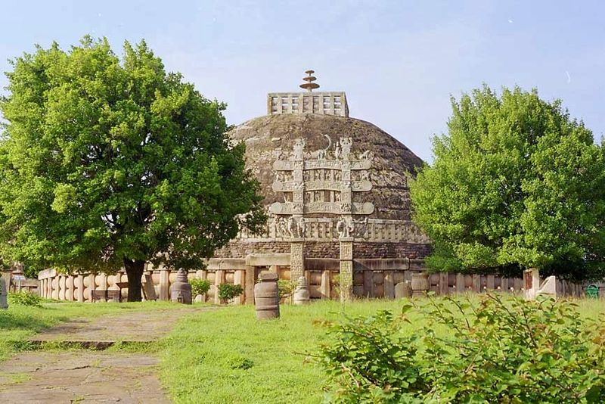
22) These spherical shrines to Buddha were erected during the classical period in India.
tripitaka
vedas
gita
stupa
D

Slide 24
23) This war/series of wars proved that Rome had organized and powerful rivals that could – and did – oppose Roman expansion in the area.
Persian War
Peloponnesian War
Periclesian War
Punic War
D
The Punic Wars were a series of three wars between the Roman Republic and the Carthaginian Empire of North Africa over control of the Mediterranean.

Slide 25
24) All of the following played a major role in disrupting classical civilizations EXCEPT:
Nomadic invasions, like those by the Xiongnu and the White Huns
Epidemics
Weak leadership
Increasing dependency on central governments
D
The Three Kingdoms period, latifundias, and collapse of the decentralized Gupta Empire indicate a lack of interest/trust in central and broad governments to provide for the people.

Slide 26
25) In Chinese tradition, the Mandate of Heaven refers to:
Chinese hatred of merchants
Belief in many gods
Eternal authority of a ruling dynasty
Divine blessings of the rule of an emperor
D

Slide 27
26) The Zhou Dynasty ended after:
The Era of the Warring States.
nomadic invaders overthrew the Zhou.
The Yangtze River flooded, destroying crops and causing a peasant revolt.
an outbreak of yellow fever killed many of the Zhou rulers.
A

Slide 28
27) During the classical era in India, all of the following occurred EXCEPT:
A) religious authorities often allowed human autopsies in the name of research.
B) the concept of zero was invented.
C) Indians developed a university.
D) spherical shrines to Buddha, called stupas, were erected.
A

Slide 29
28) In comparison to the Hindus, Jews, and Chinese, in terms of religion the Greeks:
developed a compassionate system similar to Buddhism
avoided portraying gods with human characteristics
never developed a major long-lasting religion
most resembled Hinduism’s polytheism with its caste system
C

Slide 30
29) All of the following led to Rome’s collapse EXCEPT:
Unstable leadership from weak rulers
High taxes and inflation
Droughts, famines, and plagues
Invasions from the Carthaginians
D
The Punic Wars were during the Roman Republic.

Slide 31
30) Roman culture:
owed a great deal of its diversity to trade with China.
borrowed heavily, especially from Greek culture.
influenced heavily the culture of Africa and Southwest Asia.
developed in relative isolation.
B

Slide 32
31) Identify the statement that best gives an explanation of the Neolithic Revolution.
In Northern Europe, nomadic hunters began to produce more complex stone tools.
In East Asia, early settlers began using markings on turtle shells and bones as an early form of record keeping.
In the Middle East, people began to settle in small communities and practice agriculture.
In Mesoamerica, agricultural settlements saw an expansion of their populations, and the beginning of more complex governments
C

Slide 33
32) In China, Confucianism emphasized the idea that:
societal harmony could be achieved by the proper behavior of each member of the family/society.
equality should exist among all members of society
salvation could be attained by prayer, meditation, and good deeds
individual goals should be placed ahead of the needs of the group
A

Slide 34
33) How might settlements in the Neolithic Age affect birth rates?
There was no effect.
There was no effect on birth rates but a decrease in death rates.
There was an increase in birth rates due to security and food supply.
There was more disease, so birth rates stayed very low.
C

Slide 35
34) All of the following are major African civilizations during this period EXCEPT:
Kush
Ethiopia
Crete
Axum
C

Slide 36
35) Identify the major trade network between Asia and Europe.
Trans-Saharan caravans
The Silk Roads
Indian Ocean sea lanes
Mediterranean sea lanes
B

Slide 37
36) What statement defines the dynastic cycle?
Chinese governments ruled based on the power of a single family.
While at first militarily powerful, as a dynasty came to depend more on Confucian scholars than generals, it became weaker militarily and would eventually fall to foreign invasion.
Chinese government depended upon economic growth to sustain power, and as the economy declined, based on cycles, so too did the dynasties.
Initially a Chinese government enjoyed prosperity and economic growth, but over time corruption, internal disasters, and external invasions all eroded a dynasty’s power.
D

Slide 38
37) What statement accurately compares the government of the Han dynasty with that of the Roman Republic?
Power in the Han dynasty was concentrated in a centralized bureaucracy dominated by Confucian scholars while power in the Roman Republic was shared among major landowning families of Rome.
Power in the Han dynasty rested solely with the emperor while in Rome all citizens were able to express their opinions and influence government.
Power in the Han dynasty was concentrated in a centralized bureaucracy dominated by Confucian scholars while in the Roman Republic all citizens shared power in governmental decisions.
Power in the Han dynasty rested in the hands of the military generals, while power in the Roman Republic rested in the hands of legion commanders and provincial governors.
A

Slide 39
38) Identify the sacred text that originated from the Aryan people from central Asia.
Vedas
Moksha
Samsara
Dharma
A

Slide 40
39) Identify the important original contribution of the Jewish culture to the civilizations in the Middle East and Mediterranean during the Classical Period.
Monotheism
Written legal code
Phonetic alphabet
Priest caste
A

Slide 41
40) The following statements resulted from what cultural change?
I – More reliable and abundant food supply
II – job specialization based on a surplus of food
III – development of a more formal social hierarchy
The development of complex government
The adoption of agriculture
The development of metal tools
The growth of complex, organized religion
B

Slide 42
Tie Breaker:
In what ways did the three philosophical movements of Classical China shape Chinese civilization? Write on your tablet and bring to Ms. Sheets.
Confucianism – helped to curb political disorder by stressing respect for one’s superiors, a modest life for those in power, proper manners for all; cohesive bureaucracy
Legalism – though it never had widespread appeal, Legalism’s emphasis on authoritarian tactics influenced political decision making
Daoism – brought an ethical focus and an elaborate spirituality, focus on introspection, inner peace, and nature’s beauty

