Slide 1
Objectives: 1. Summarize Confucian ideas about the family and about society 2. Identify ethical systems 3. Describe the rise and fall of the Qin Dynasty
FIRST: DISCUSS How well do people RESPECT authority?
Parents, Teachers, Police, Older People, Other

Slide 2
The Unification of China
& the QIN DYNASTY
The social disorder of the warring states contributes to the development of three Chinese ethical systems.
NEXT

Slide 3
The Unification of China
Confucius and the Social Order
Zhou Dynasty
• Lasted 1027 to 256 B.C.; ancient values decline near
end of dynasty
Confucius Urges Harmony
• End of Zhou Dynasty is time of disorder
• Scholar Confucius wants to restore order,
harmony, good government
• Stresses developing good relationships, including
family
• Promotes filial piety—respect for parents and
ancestors
• Hopes to reform society by promoting good
government
Continued . . .
NEXT

Slide 4
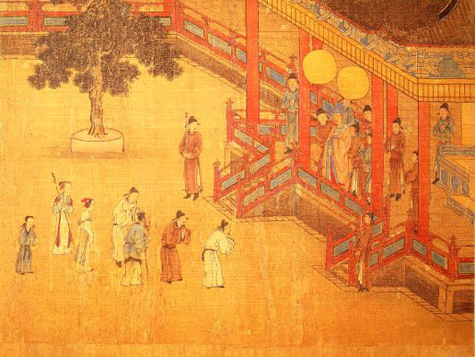
Chinese painting (12th century) showing filial piety.

Slide 5
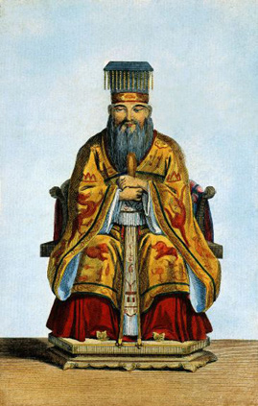
Confucius (551-479 B.C.), Chinese philosopher. Aquatint (19th century).

Slide 6
continued Confucius and the Social Order
Confucian Ideas About Government
• Thinks education can transform people
• Teachings become foundation for bureaucracy,
a trained civil service
• Confucianism is an ethical system of right and
wrong, not a religion
• Chinese government and social order is based on
Confucianism
NEXT

Slide 7
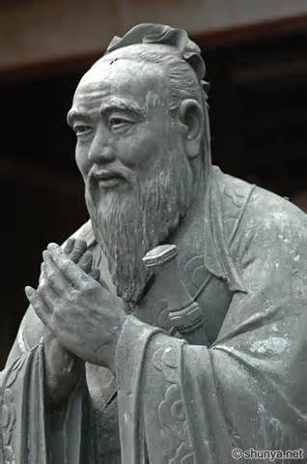
Critical Thinking
What can you INFER about his attitude toward WOMEN?
How did the creation of a BUREAUCRACY promote equality?
He was less concerned with women than men.
Government jobs were open to all who became educated, not just wealthy

Slide 8
Other Ethical Systems
Daoists Seek Harmony
• Laozi teaches that people should follow the
natural order of life
• Believes that universal force called Dao guides
all things
• Daoism philosophy is to understand nature and
be free of desire
• Daoists influence sciences, alchemy, astronomy,
medicine
Legalists Urge Harsh Rule
• Legalism emphasizes the use of law to restore order; stifles criticism
• Teaches that obedience should be rewarded,
disobedience punished
Continued . . .
NEXT

Slide 9
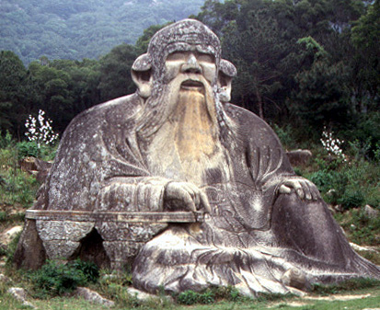
Statue of Laozi (Lao Tzu), Chinese philosopher (6th century B.C.).

Slide 10
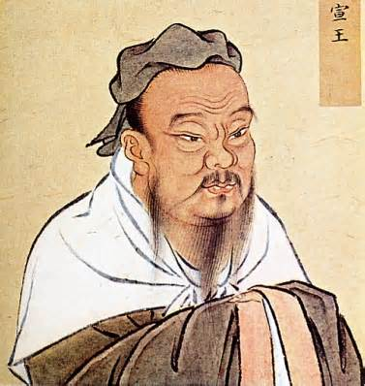
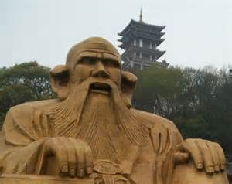
CONFUCIUS and LAOZI Which would you rather have as a teacher and why?

Slide 11
CONFUCIANISM | DAOISM | LEGALISM
Social Order, Harmony, and good government should be based on family relationships | The natural order is more important than social order | A highly efficient and powerful government is the key to social order.
Respect for parents and elders is important to a well-ordered society | A universal force guides all things | Punishments are useful to maintain social order.
Education is important both to the welfare of the individual and to society | Human beings should live simply and in harmony with nature | Thinkers and their ideas should be strictly controlled by the government.
Which of the 3 systems stresses the importance of government and a well ordered society?
CONFUCIANISM
LEGALISM
Which of these systems seems to be the most moderate and balanced? EXPLAIN?
CONFUCIANISM = because it avoids the Daoist emphasis on natural order and the Legalist emphasis on punishment and control

Slide 12
continued Other Ethical Systems
I Ching and Yin and Yang
• I Ching (The Book of Changes) offers good advice,
common sense
• Concept of yin and yang—two powers represent
rhythm of universe
• Yin: cold, dark, soft, mysterious; yang: warm, bright,
hard, clear
• I Ching and yin and yang explain how people fit into
the world
NEXT

Slide 13
CRITICAL THINKING
Explain this quote from LAOZI, “When there is no desire, all things are at peace.
Explain how I CHING was similar to the teachings of Confucius.
People need to reduce their desires so they can live in peace.
Both provided guidance on ethics.

Slide 14
Chinese symbols yin (earth, female element) and yang (heaven, male element).
Make a list of DUALITIES:
EXAMPLES: Good/Evil, Day/ Night

Slide 15
Apply a Chinese ETHICAL system
Break into 3 Groups
Each groups represents either CONFUCIANISM, DAOISM, or LEGALISM
Explain WHY your ETHICAL SYSTEM is best for solving the following problems:
1. POLLUTION 2. CHEATING 3. HOMELESSNESS 4. CRIME 5. TERRORISM
Be prepared to present to the class.
HAVE FUN!

Slide 16
Explain WHY your ETHICAL SYSTEM is best for solving the following problems:
1. POLLUTION 2. CHEATING 3. HOMELESSNESS 4. CRIME 5. TERRORISM
CONFUCIANISM | DAOISM | LEGALISM
Social Order, Harmony, and good government should be based on family relationships | The natural order is more important than social order | A highly efficient and powerful government is the key to social order.
Respect for parents and elders is important to a well-ordered society | A universal force guides all things | Punishments are useful to maintain social order.
Education is important both to the welfare of the individual and to society | Human beings should live simply and in harmony with nature | Thinkers and their ideas should be strictly controlled by the government.

Slide 17
The Qin Dynasty Unifies China
The Qin Dynasty
• Qin Dynasty replaces Zhou Dynasty in third
century B.C.
A New Emperor Takes Control
• Emperor Shi Huangdi unifies China, ends fighting,
conquers new lands
• Creates 36 administrative districts controlled by Qin
officials
• With legalist prime minister, murders Confucian scholars, burns books
• Establishes an autocracy, a government with
unlimited power
Continued . . .
NEXT

Slide 18
continued The Qin Dynasty Unifies China
A Program of Centralization
• Shi Huangdi builds highways, irrigation projects;
increases trade
• Sets standards for writing, law, currency, weights and
measures
• Harsh rule includes high taxes and repressive
government
Great Wall of China
• Emperor forces peasants to build Great Wall to keep
out invaders
The Fall of the Qin
• Shi Huangdi’s son loses the throne to rebel leader;
Han Dynasty begins
NEXT

Slide 19
Was Shi Huangdi justified in requiring peasants to work on the Great Wall? Make a Argument for BOTH YES and NO.
YES, For the good of Society
NO, Unfair

Slide 20
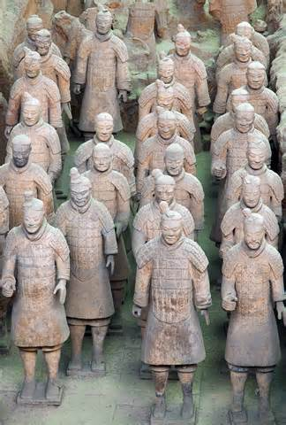
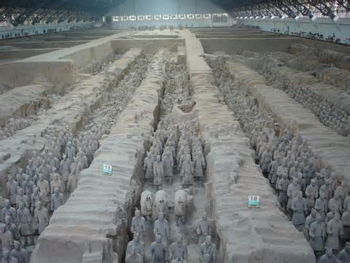
More about SHI HUANGDI

Slide 21
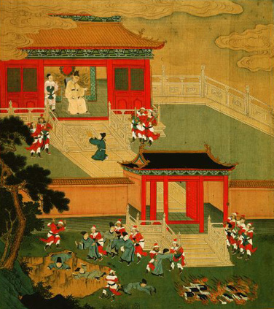
Emperor Shi Huangdi (Qin dynasty, 221-202 B.C.), burning books and killing scholars.

Slide 23
Fill is the Chart comparing other large scale structures.
WHAT? | WHERE? | WHY BUILT?
Great Wall of China | Northern China | Defense, maybe to keep soldiers busy
Hanging Gardens
Taj Mahal
Panama canal
YOU PICK SOMETHING?

Slide 24
How did Confucius believe that social order, harmony, and good government could be restored to China?
Organize society around 5 basic relationships
What did the Legalists see as the key to restoring order?
Efficient, powerful government
What measures sis Shi Huangdi take to crush political opposition at home?
Ordered noble families to live in the capital, divided into districts, murdered scholars and burned books
How would followers of the 3 philosophical traditions in China react to the idea that “all men are created equal”?
None emphasized equality, so all would have rejected it.
Why did Shi Huangdi have critics murdered?
Fear of those who disagreed with them
Would a ruler who followed Confucian or Daoist ideas have built the Great Wall? Why or Why not?
No, because the ruler would not have been as ruthless or controlling

