Slide 1
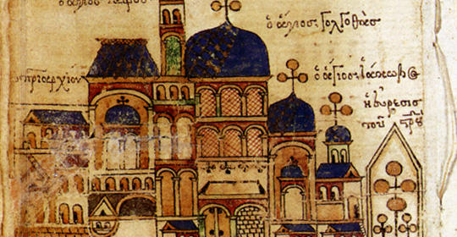
Chapter 9: Civilization in Eastern Europe: Byzantium and Orthodox Europe
Ms. Sheets
AP World History

Slide 2
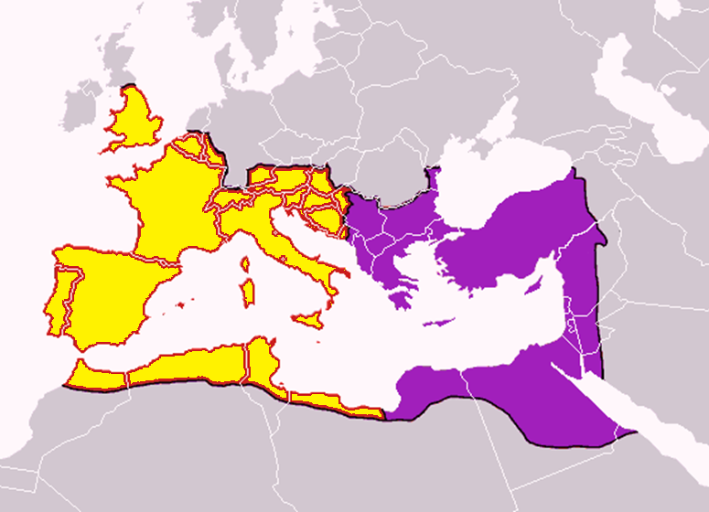
Political and Religious Division
Two Christian civilizations develop out of the split of Roman Empire.
East (Greek Orthodox)
West (Roman Catholic)
Each participated in major trade routes.
Civilizations expand and spread north largely because of religious missionaries.
Religions are culturally, and later even organizationally, separate

Slide 3
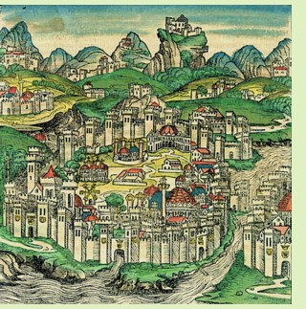
Summary of Byzantine Empire
High levels of political, economic, and cultural activity during much of 500-1450
Rulers saw themselves as Roman emperors; government was seen as continuation of Roman Empire
Constantinople = capital (cosmopolitan, opulent, wealthy)
Greek/Eastern Orthodox Christianity
Retain strength despite rapid growth of Islam
Spread culture (religion) and politics to parts of world that had not been controlled by any major civilization
Balkans, western Russia

Slide 4
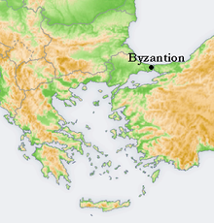
Origins
Emperor Constantine of Roman Empire built Byzantium/ Constantinople in 4th c.
End of 4th CE: Roman Empire officially divided into East/West with capitals at Rome and Constantinople
Political style in East: complex administration centered around emperor with elaborate ceremonies
Involved in Mediterranean and Central Asian commerce

Slide 5
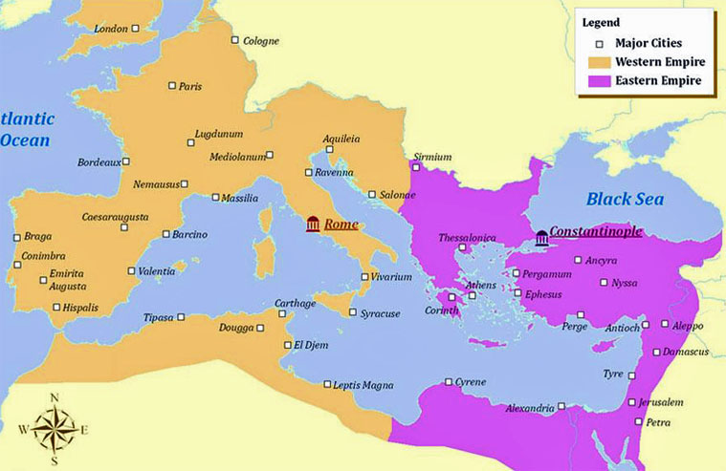

Slide 6
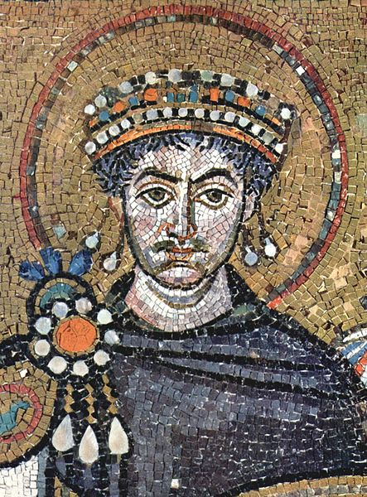
Justinian (Reigns 527-565)
Most significant Byzantine ruler
Military gains and huge expansion to rebuild original Roman Empire
Gains in North Africa and Italy
Systemizes Roman legal code
Influences future law codes in Europe
Reduces legal confusion; united and organized the new empire
Projects to renovate Constantinople
Hagia Sophia – engineering and architectural achievements (dome)
Makes Greek language official
Political resistance from other groups

Slide 7
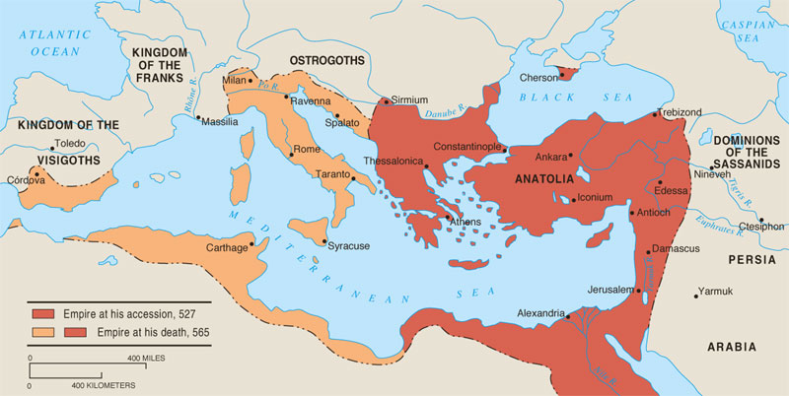
Byzantine Height under Justinian

Slide 8
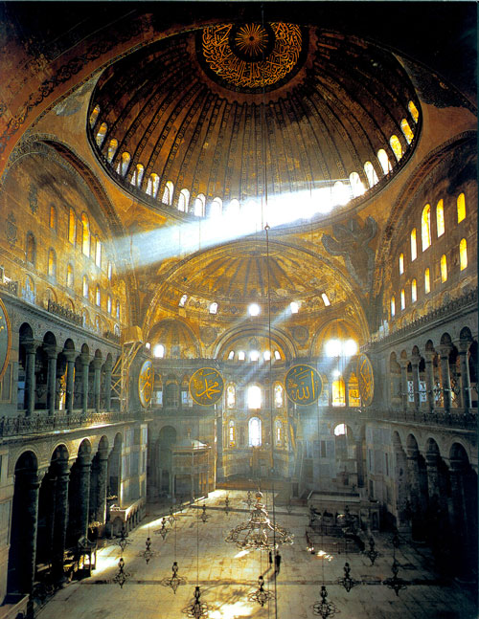
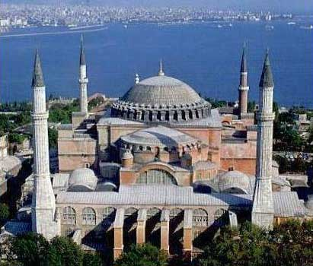
Hagia Sophia

Slide 9
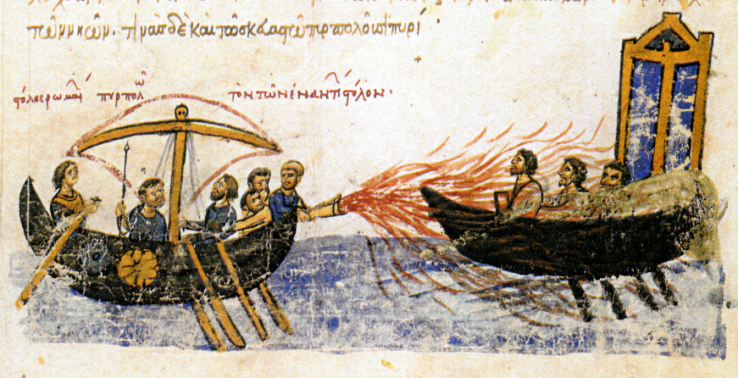
Arab Pressure and Byzantine Defenses
After Justinian, Byzantine rulers’ primary concern is defense of empire against Arab invaders
Able to hold off Arab Muslims but with losses in Mediterranean
Arab naval fleet; battle over Mediterranean; “Greek fire”
Empire’s size/strength reduced
Economic burdens and loss of territory from Muslim wars
Increase in taxes; increase in wealth for upper class
Weak emperors

Slide 10
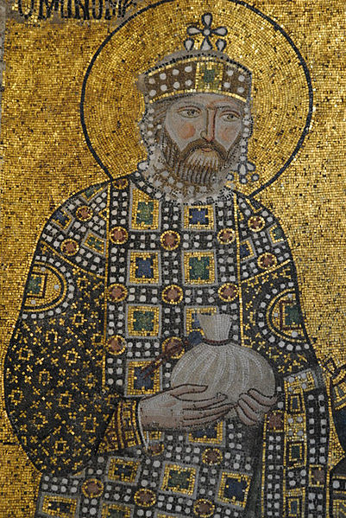
Byzantine Politics
Emperors were the head of the government and the center of elaborate court rituals focusing upon their divinely inspired, all powerful nature.
Sophisticated and highly educated bureaucracy that was open to all classes (but aristocrats dominate).
Bureaucracy helped to organize empire politically, socially, and economically.
Provincial governors appointed
Control economy via regulation of food prices, trade (with Asia, Russia, Scandinavia, W Europe, Africa), and silk production.
Monomachus

Slide 11
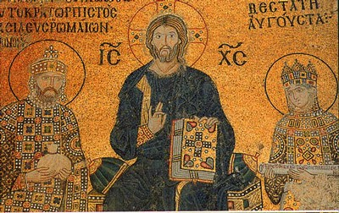
Byzantine Culture
Creativity in Architecture (domed buildings)
Richly colored religious mosaics in a distinct Byzantine style
Icon paintings (paintings of saints and religious figures)
Cultural life blended Hellenism and Orthodox Christianity
Monomachus, Christ, and Empress Zoe

Slide 12
Split Between
Eastern and Western Christianity
Separate paths emerge in 11th c. over disagreements
Attempted papal interference in Byzantine political and religious affairs
Debate over clerical celibacy (W – yes, E – no)
Dispute over bread to be used in Eucharist
Should state control religion (East)? Or should religion control state (West)?
West translates Greek Bible into Latin; East feels this isolates people from services
1054: Patriarch Michael attacks Catholic practices
Mutual excommunication (patriarch and Pope Leo IX)
Church splits into two traditions: Greek/Eastern Orthodox and Roman Catholicism

Slide 13
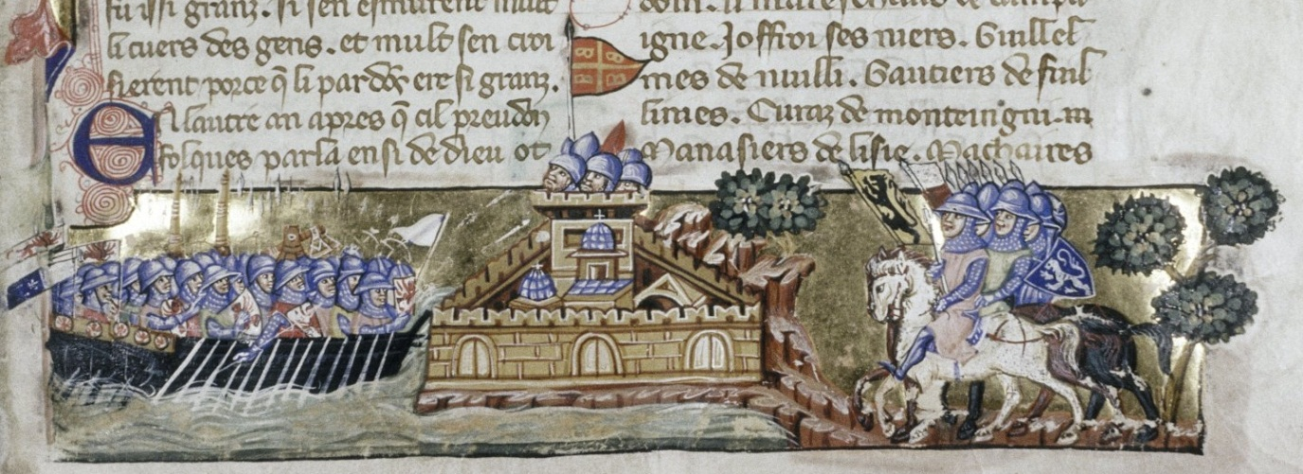
Byzantine Decline
Decline begins after 1054 (Church schism)
1071: Seljuk Turks take most of Central Asian provinces at Battle of Manzikert
Independent Slavic states emerge which diminish Byzantine power
1204: Crusaders sack Constantinople; West cannot topple it
1453: Constantinople taken by Ottoman Turks
3 Groups contribute to destruction of Byzantines
Seljuk Turks (Battle of Manzikert)
Emerging independent Slavic states in Balkans (Bulgaria and Serbia)
Western crusaders

Slide 14
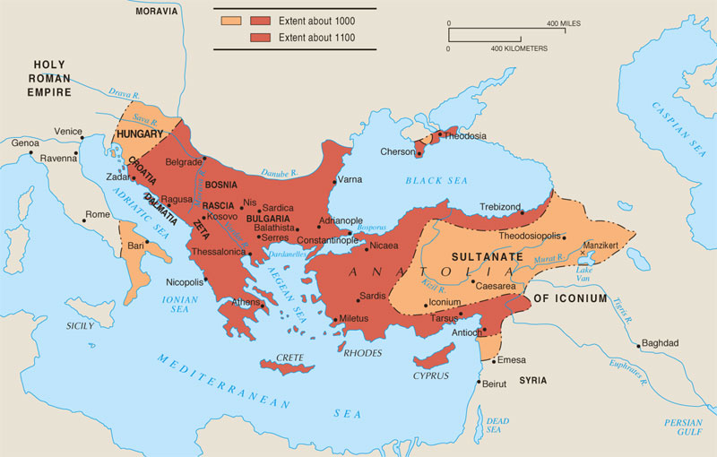
The Byzantine Empire (1000-1100)
Byzantine Empire went from a major to minor power after the Turkish defeat at Manzikert in 1071

Slide 15
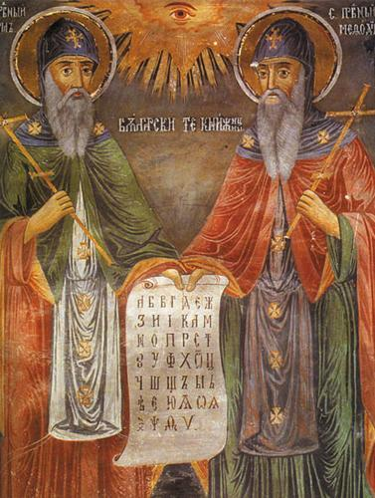
Spread of Civilization in Eastern Europe
Eastern Europe is influenced by Byzantine conquest, Christian missionaries and conversion efforts, and trade routes
Byzantine Christian missionaries (Cyril and Methodius) helped bring Orthodoxy northward into Russia and the Balkans
Create new alphabet: Cyrillic script

Slide 16
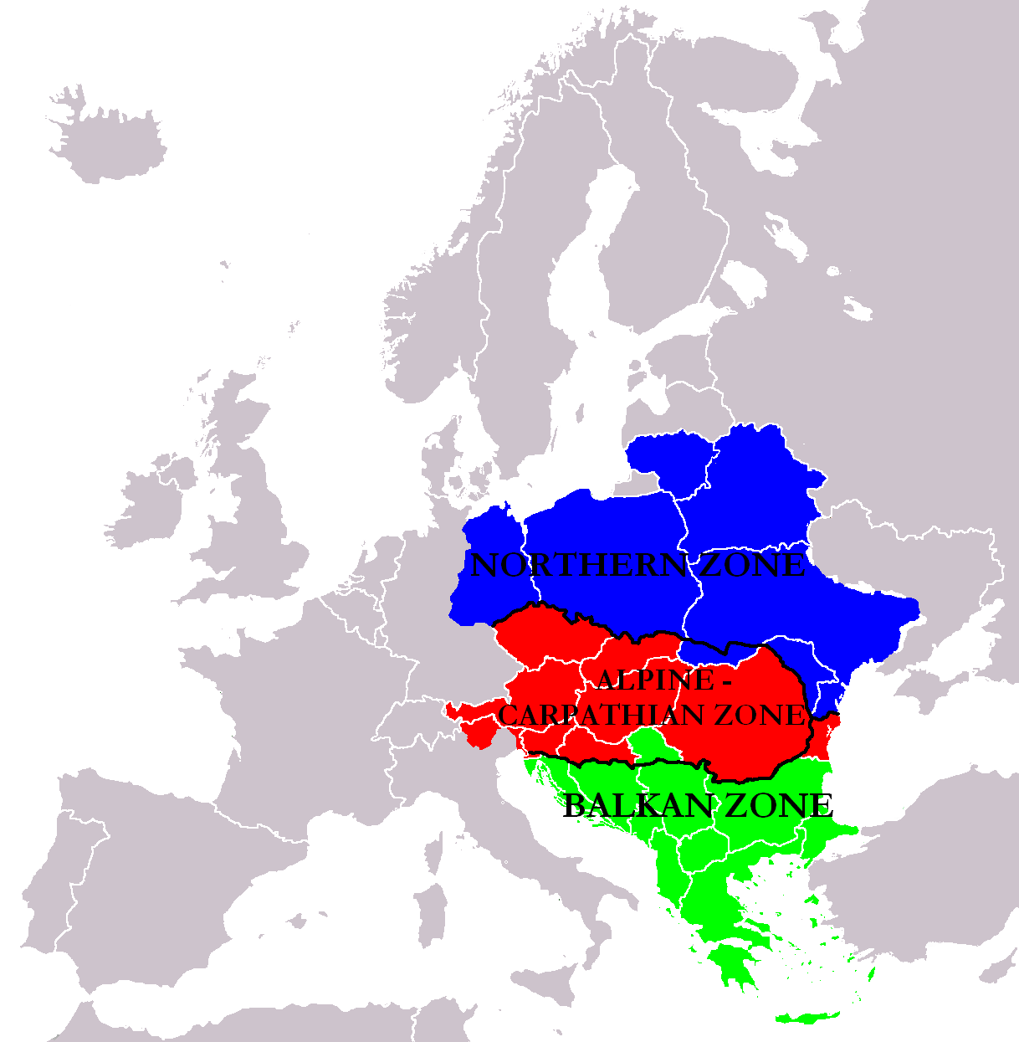
The East Central Borderlands
Competition between Catholics and Orthodox Greeks for converts
Catholic converts are mostly in Hungary, Poland
Influx of Jews to Borderlands from Western Europe and Middle East to escape persecution
Migrate into region in large numbers (Poland)
High value placed upon education and literacy
Limited professions available; gain strength in local commerce
Resented by Christian community

Slide 17
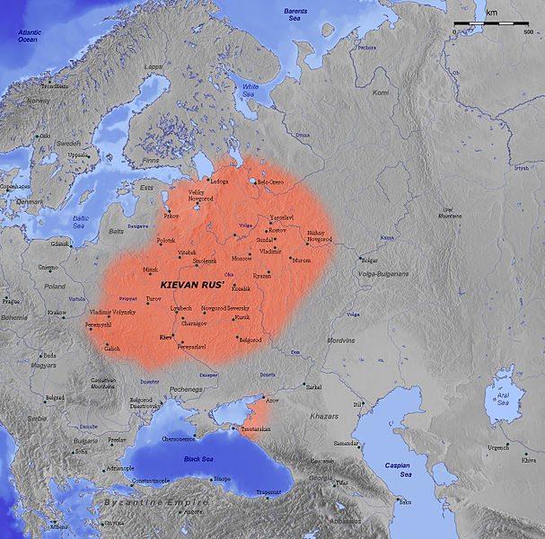
The Emergence of Kievan Rus’
Who are the Russians?
Groups from Asia moved into region during Roman Empire
Agricultural society of tribes, villages
Animist religion (sun, thunder, wind, fire)
Conduit for trade between Byzantines and Scandinavia
Luxury products from Silk Roads traded for furs from Scandinavia
855: large trading city (Kiev) became site of monarchy under Prince Rurik, first Prince of Kievan Rus’

Slide 18
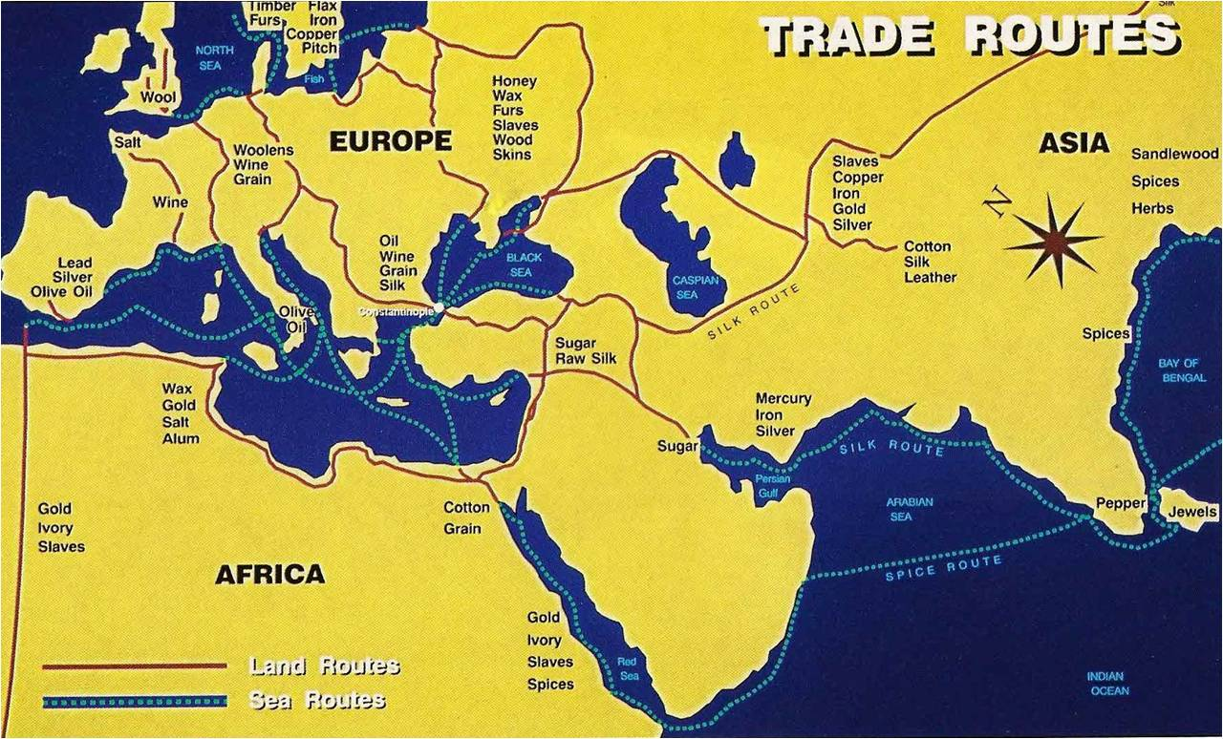

Slide 19
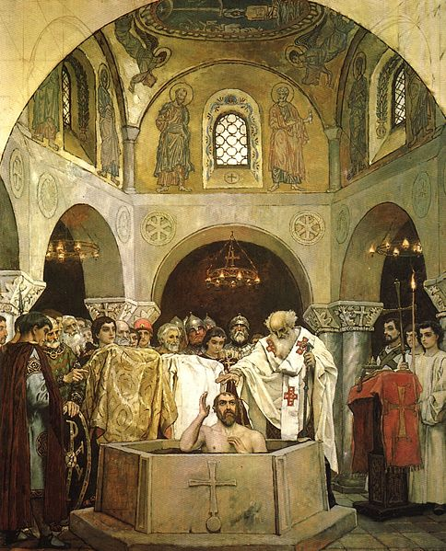
Politics and Religion in Kievan Rus’
Vladimir I (980-1015)
What religion to choose?
1000: Converts to Orthodoxy on behalf of all his people; organizes mass baptisms and forced conversions with military pressure.
Develops Russian Orthodox Church
Controls church and creates literate Russian priesthood
Yaroslav (1019-1054)
Develops and issues unifying law code
Arranged marriages with central European royalty
Translates religious literature from Greek to Slavic
Conversion of Vladimir I

Slide 20
Culture in Kievan Rus’
Kievan Rus’ forms core of Russian culture and politics
Largest single state in Europe at this time
Russian culture borrowed much from Byzantium
Attracted to ceremony and luxury of Byzantium
Peaceful and trade-oriented relationship between Byzantium and Kievan Rus’ helps to facilitate cultural exchange
Greek Orthodox influence on Russian Orthodox Church
Ornate churches, filled with icons and incense
Monasticism develops, stress prayer and charity
Fervent religious devotion
Cultural production dominated by religion
Art (icons, illuminated manuscripts), literature (using Cyrillic)
No interest in philosophy or science
Boyars, landlords/Russian nobility, less powerful than in West
Farmers are free

Slide 21
Kievan Decline
Decline from 12th century
Kievan Rus’ was not the only kingdom in this region; other regional leaders and princes have large rival governments
Succession struggles within royal family
Central Asian invaders chip away at territory
Fall of Byzantium reduces Russian trade and wealth
Mongols (Tatars) invade in 13th century
Aided by rival princes, Mongols take major cities easily
Control much of Russia for over two centuries
Two factors for Kievan Decline:
1) Fall of Byzantine empire and 2) Mongol invasions
Orthodox Christianity and Russian culture remain

Slide 22
Global Connections
Byzantine Empire
Participated actively in interregional trade
Constantinople: great trading city, connection between East and West
Maintained strong empire despite rapid surge of Islam, as well as developing cultural innovations and Orthodox Christianity
Kievan Rus’
Dependent on Byzantium as main trading connection
Period of decline and isolation when Byzantium declines and Mongols invade
East cut off from western contacts, which stifles economic, political, and cultural sophistication. This will occur just as the West will begin to grow and strengthen.

