Slide 1
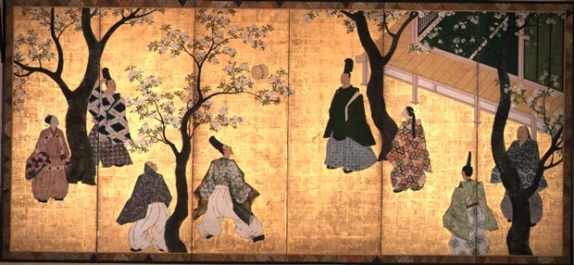
Chapter 13: The Spread of Civilization - Japan, Korea, Vietnam

Slide 2
Japan’s Imperial Age
5th c: Yamato clan emerged as emperors
6th -7th c.: Chinese culture increasingly influences Japan
Taika, Nara, and Heian periods (7th to 9th centuries)
Tremendous borrowing from China (Sinification)
645 CE: Taika Reforms
Copy Chinese style of rule in Japanese government
Try to develop bureaucracy to limit power of aristocracy; opposed by aristocracy
Confucianism rejected; Japan held birth in esteem, not education

Slide 3
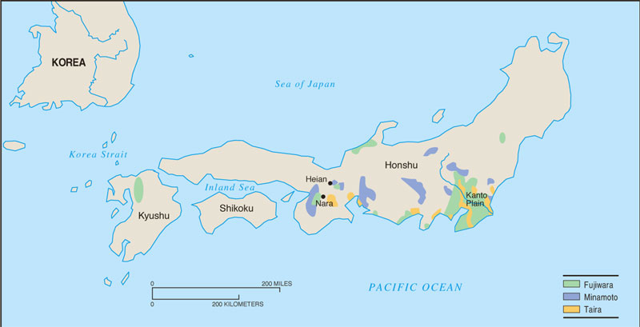
Heian Period
794: Capital moved from Nara to Heian (later Kyoto)
Chinese influence declined
838: Japanese embassies to Tang China stopped
Taika reforms abandoned
Power of aristocratic families increases (Fujiwara)

Slide 4
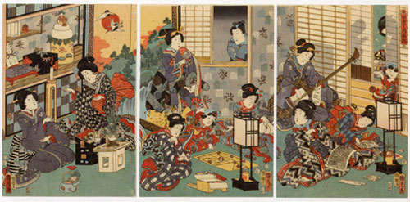
Court Life in the Heian Era
Extremely refined; based upon codes of behavior
Aesthetic enjoyment
Literary Golden Age: poetry, love notes, stories Women and men take part in literary production
Lady Murasaki’s Tale of Genji
Growing isolation of the court provided opportunities for regional lords with a more military orientation to seize effective control of Japan.

Slide 5
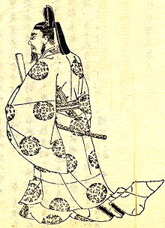
Increase of Powerful Families
Fujiwara, Taira, Minamoto
Aristocrats begin to rebel against Chinese influence in imperial government
Aristocratic families begin to dominate government and shape policies through the accumulation of their own armies and large estates
Many aristocrats become bushi (regional war-lords) who administer these territories and armies
Aristocrats marry into imperial family to control policy
Cooperate with Buddhists and create elite cult within Buddhism

Slide 6
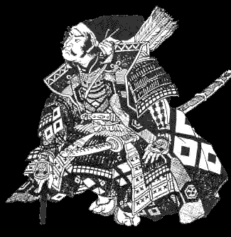
Creation of Feudal Japan
Regional lords (bushi) administer small kingdoms, collect taxes, and build up private militaries
Samurai (armed military troops) begin as loyal warriors to bushi
Martial arts esteemed
Code of Bushido stresses family honor and ritual suicide (seppuku) rather than defeat
Serfs (peasants) lose status and freedom, and are treated as property of local lord
Turn to salvationist Buddhism (live upright lives on Earth)

Slide 7
Decline of Imperial Power
and Creation of Shogunate
Japanese feudalism means emperor’s power declines
By 11th/12th c., aristocratic families dominate and are in control at court
1180-1185: Gempei Wars
Battle between Taira and Minamoto families over political control
Minamoto victorious and control court
Minamoto establish Bakufu (military government) headed by a shogun (military leader)
Emperor and court remain; Minamoto family and samurai have real control in shogunate

Slide 8
Chaos Continues
1336-1573: Ashikaga Shogunate established; collapse of centralized authority as emperor flees upon his refusal to recognize shogun
Power of emperor and shogunate weakens, however.
14th c: Period of civil war between aristocratic families
Bushi vassals acquire more land
Land then divided among samurai upon pledging loyalty to vassals to give military assistance when needed
1467-1477: Court rebellions continue, and Japan fragments into 300 small kingdoms led by warlords called daimyos

Slide 9
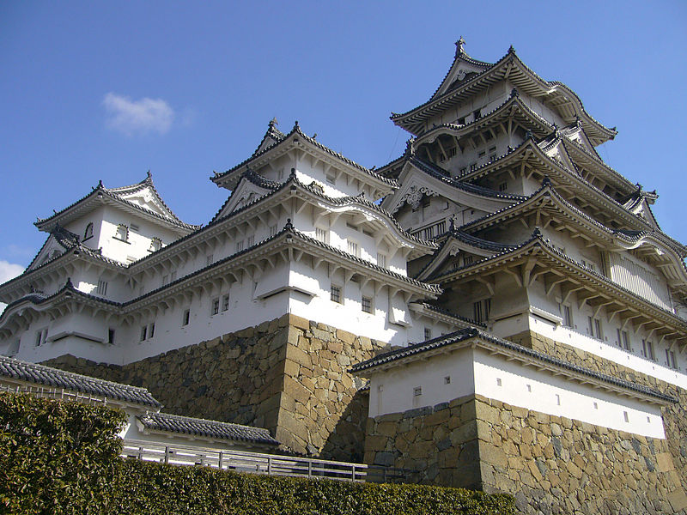
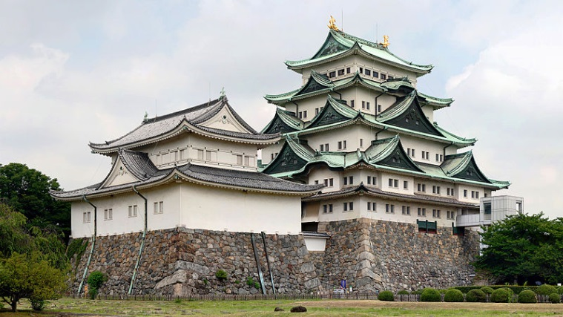
Violence and Centralization
Bushido era deteriorates and an era of barbarism emerges
Military division, social change, peasant violence
Warfare becomes more brutal
Battles determined more by size and organization of warlord’s forces than the outcome of ritualized samurai combat
Poorly trained peasant armies
Construction of castles
Japan moves towards greater centralization
Taxes are collected to fund public works projects (irrigation; roads)

Slide 10
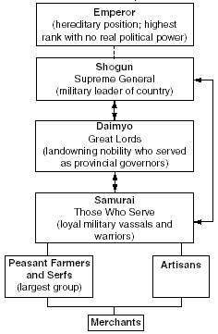
Japanese Feudalism

Slide 11
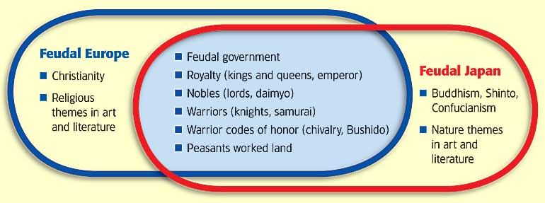
Feudal Europe vs. Feudal Japan
Similar:
political structure, social structure, code of honor
Difference:
Europe: simply a land-for-loyalty exchange
Japan: based upon group/family identity and loyalty

Slide 12
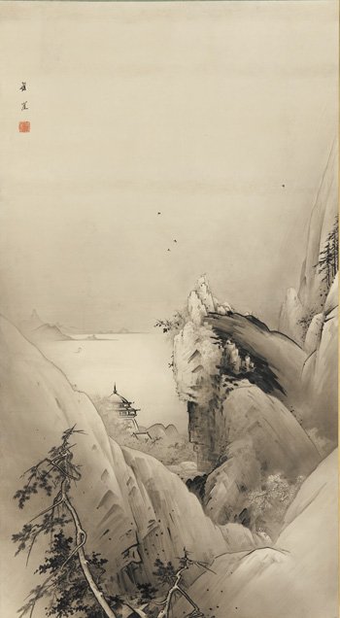
Economy and Culture
Economic growth result of daimyo interest in trade, even with China
Development of standardized currency
Increase in guilds
Shinto + Zen Buddhism exist simultaneously
Art is stylistically simple
Mimic monochrome Chinese style
Ink sketches
Screen and scroll paintings
Show natural beauty of Japan
Landscapes with tiny human figures
Development of tea ceremonies and Zen Buddhist gardens

Slide 13
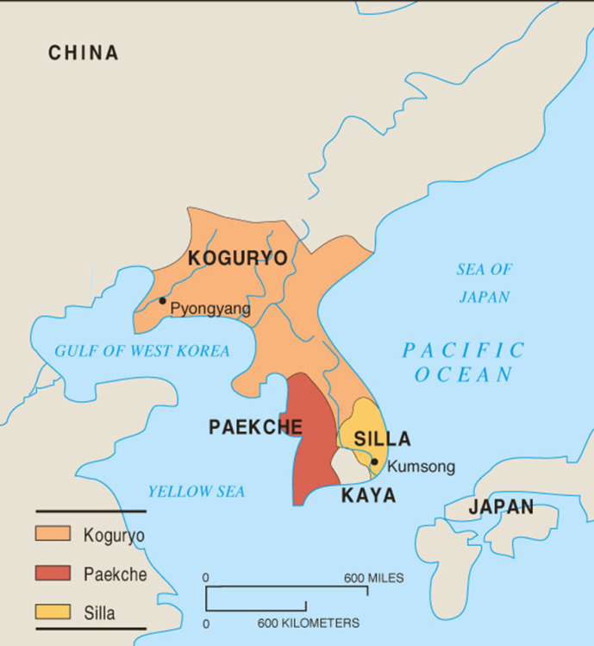
Korea
3 kingdoms: Koguryo, Paekche, Silla
Sinification (adoption of / interest in Chinese culture)
Increases after Han (cities, schools, and court organized like Chinese)
Power of aristocracy prevents total adoption of Confucianism
Buddhist art, monasteries
Chinese writing, Chinese law code affect Korea
668: Tang Dynasty conquers Korea; now a tribute state
1231, Mongol invasion, followed by turmoil
1392, Yi dynasty founded, lasts until 1910

Slide 14
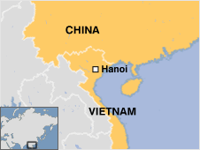
Vietnam
When Tang armies invade, Viet actively resisted them.
Viets tried to retain distinctiveness but eventually Vietnam is made a tribute state
Chinese culture systematically introduced: Confucianism, government structure, contact through trade
Culture of anti-Chinese resistance develops
Resistance from aristocracy, peasants, women
Distance from China aids resistance
Independence by 939 until 19th century
Rivalries in native Vietnamese ruling families until 19th century will leave Vietnamese oblivious to outside threats: French and Catholic Church

