Slide 1
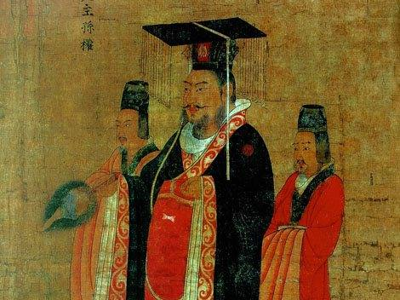
Chapter 12 Reunification and Renaissance in Chinese Civilization: The Tang and Song Dynasties

Slide 2
Connecting to Before
Xia, Shang, Zhou, Era of Warring States, Qin, Han, Three Kingdoms Period (Northern Qi; Northern Zhou; Chen)
Han has fallen as a result of the usual peasant uprisings and collapsing bureaucracy, and China fragments into three kingdoms who fight for total control of China’s territory
China is now largest empire (population + territory)

Slide 3
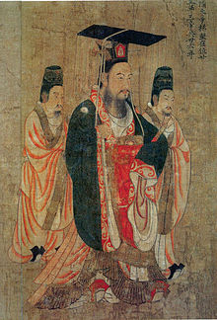
Sui Dynasty 589-618
Return to strong dynastic control in China
Wendi, Northern Zhou Emperor
Northern Zhou defeated rivals and had united much of northern China
Secures support of neighboring nomads, controls northern China
589, defeats remaining Chen kingdom and establishes Sui Dynasty over China
Favored: lowering taxes, establishing granaries
Buddhist; expands Buddhism

Slide 4
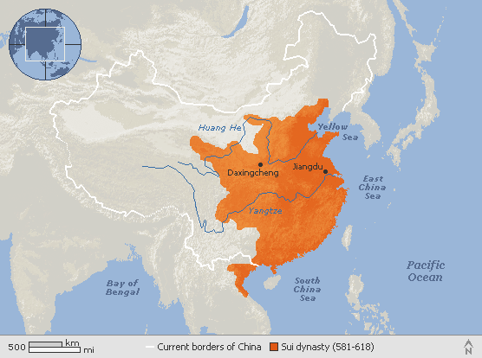

Slide 5
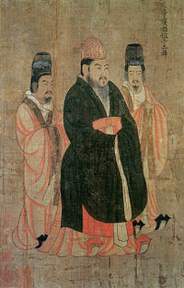
Sui Collapse
Yangdi, Son of Wendi
Continues conquests, drives back nomads
Creates milder legal code
Supports reorganized Confucian education
Scholar-gentry reestablished
Restore examination system
Expensive building projects
Loyang (new capital), Grand Canal, palaces
611-614: Attack Korea, failure
618: Assassinated by own ministers

Slide 6
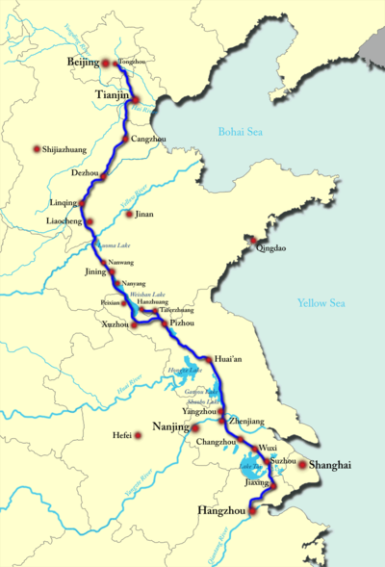
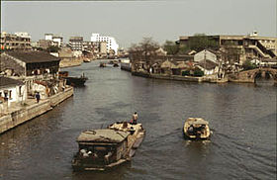
Grand Canal
Canal system (Sui and Tang)
Built to accommodate population shift and transportation of goods and revenue
Millet in North, and rice in south
Yangdi’s Grand Canal
Links North to South
1,100 miles long
1 million forced laborers

Slide 7
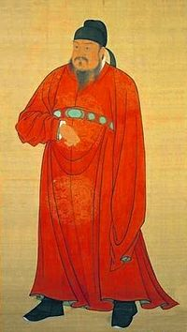
Tang Dynasty 618-907
Li Yuan, Duke of Tang (one of Yangdi’s officials) becomes Emperor Gauzo of Tang
Uses his armies to unite China
Use of Turkish nomads in army
Expands empire into Tibet, Vietnam, Manchuria, Korea
Great Wall repaired and strengthened
Yangtze River basis and much of the south were fully integrated with north China for first time since Han

Slide 8
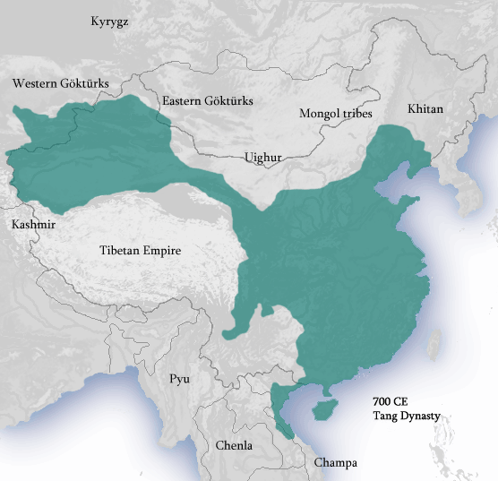
Tang Dynasty at greatest extent

Slide 9
Rebuilding the Bureaucracy
Tang monarchs need to rebuild and expand imperial bureaucracy since it had fallen apart after collapse of Han
Goal #1: Revive scholar-gentry (bureaucrats)
Create large bureaucracy of loyal, well-educated officials to govern vast empire
Levels from: Imperial palace to small district
Scholar-gentry offsets power of aristocracy, which declines
Goal #2: Rework Confucian ideology
Educate bureaucrats in Confucian classics
Emphasize importance of Confucian philosophy for an effective government

Slide 10
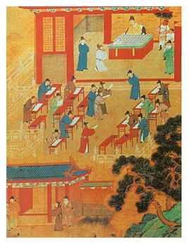
The Growing Importance of the Examination System
Number of educated scholars rises
Examination system greatly expanded
Ministry of Rites established to administer exams
Jinshi: those who passed very difficult exams on philosophy, legal texts, Chinese literature
To become a bureaucrat and take exam: must be recommended by scholar or go to government school
Special social privileges emerge
Enhanced social position of scholar-gentry provided basis for return to a highly centralized rule under an imperial dynasty

Slide 11
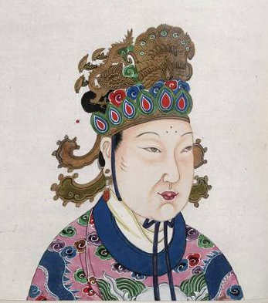
State and Religion in the Tang
Despite Tang government’s support for Confucianism, Buddhism gained wide acceptance
Mahayana Buddhism popular among commoners in era of turmoil
Chan (Zen) Buddhism common among elite
Early Tang support Buddhism
Empress Wu (690-705)
Endows monasteries (50,000 monasteries by 850)
Tried to make Buddhism the state religion
Commissioned Buddhist sculptures

Slide 12
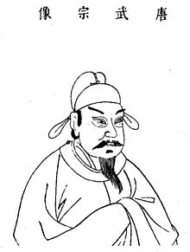
The Anti-Buddhist Backlash
Buddhist success leads to criticism by Confucians
Confucians support taxation of Buddhist monasteries and decry property given to monasteries; try to convince Tang rulers of loss of money
Support native Confucianism
841-847: Persecution under Emperor Wuzong
Shrines and monasteries destroyed
Lands redistributed to peasants
Confucian emerges the central ideology as Buddhism is weakened

Slide 13
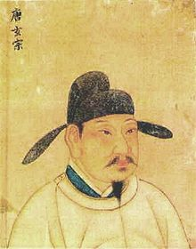
Tang Decline
8th century: Nomadic invasions, internal rebellions, military weakness
Defeated at Battle of Talas, 751
Emperor Xuanzong (713-756)
Height of Tang power, but poor ruler
His favorite concubine, Yang Guifei, grew powerful; relatives received government positions.
755: An Lishan Rebellion
General An Lishan leads mutiny and declares himself Emperor in Northern China
Xuanzong flees to Sichuan province
Does not topple Tang, but weakens it significantly
907: last Tang emperor resigns
China appears to be entering period of nomadic dominance, political division, social strife
Emperor Xuanzong

Slide 14
Five Dynasties and Ten Kingdoms Period 907-960
Five Dynasties in Northern China succeeded one another rapidly
Later Liang
Later Tang
Later Jin
Later Han
Later Zhou (General Zhao Kuangyin conquers other kingdoms and unifies China)
Ten Kingdoms in Southern China existed concurrently and controlled their own territory
Wu
Wuyue
Min
Chu
Southern Han
Former Shu
Later Shu
Jingan
Southern Tang
Northern Han

Slide 15
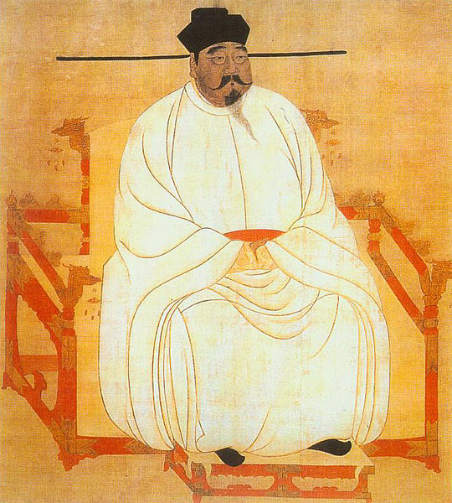
Song Dynasty 960-1279
Northern Song: 960-1127
Southern Song: 1127-1279
960: General Zhao Kuangyin (renamed Emperor Taizu) founds Song Dynasty
Overcomes all rivals but one: nomadic Liao dynasty in Manchuria (Founded by Khitan nomads)
Song unable to defeat these nomads so the Song pay tribute to Liao to keep them from raiding

Slide 16
Neo-Confucians
Revivers of pure Confucian thought and teachings
Libraries established, old texts recovered
Stress personal morality
Importance of philosophy in everyday life
Hostility to foreign ideas (Buddhism and Daoism are superstitious, and have tainted Confucianism)
Gender, class, age distinctions reinforced
These things will ensure social harmony
Become the dominant interpretation of Confucianism

Slide 17
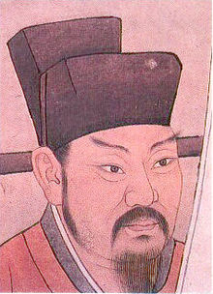
Attempts at Reform
Wang Anshi (1070s-1080s)
Confucian scholar, chief minister of Song
Institutes reforms in attempt to save dynasty’s finances
Supported agricultural expansion
Landlords, scholar-gentry taxed
Tries to begin a bureaucracy that stresses analytical thinking rather than memorization of classics
1085: Emperor Shenzong supporting Wang Anshi dies, and reforms are reversed by neo-Confucians and new emperor

Slide 18
Southern Song Dynasty 1127-1279
Khitan Liao independence encourages others to invade borders of Song China
Tangut tribes from Tibet establish Xi Xia kingdom
Song pay tribute, begins to drain economy
1115: Jin Kingdom founded north of Song Empire (defeated Liao)
Jin invade China and the Song, who are weak, flee south
Southern Song Dynasty (1127-1279)
New capital at Hangzhou: sophisticated, wealthy
Numerous cultural and technological innovations

Slide 20
A New Phase of Commercial Expansion
With canal systems and Silk Roads, commercial expansion is booming
Commerce expands in cities and trading towns
Credit, deposit shops (banks), flying money (credit vouchers)
Urban growth and sophistication
Changan, Tang capital: 2 million, largest city in world
Hangzhou, S. Song capital

Slide 21
Silk Roads
Tribal societies previously living in isolation along the Silk Road were drawn to the riches of the Silk Road. Many barbarian tribes became skilled at raiding traders.
Chinese rulers protect trade and travelers on Silk Roads
Cities developed all along the Silk Roads as trading posts and as rest stops for travelers.
From Persia: dates; saffron; pistachio; rugs; tapestries
From Africa: frankincense; aloe; gold; salt; timber
From India: sandalwood; jasmine; cloth
From China: silk; porcelain; paper; tea
Transmission of art and religion (Buddhism; Christianity; Islam)

Slide 22
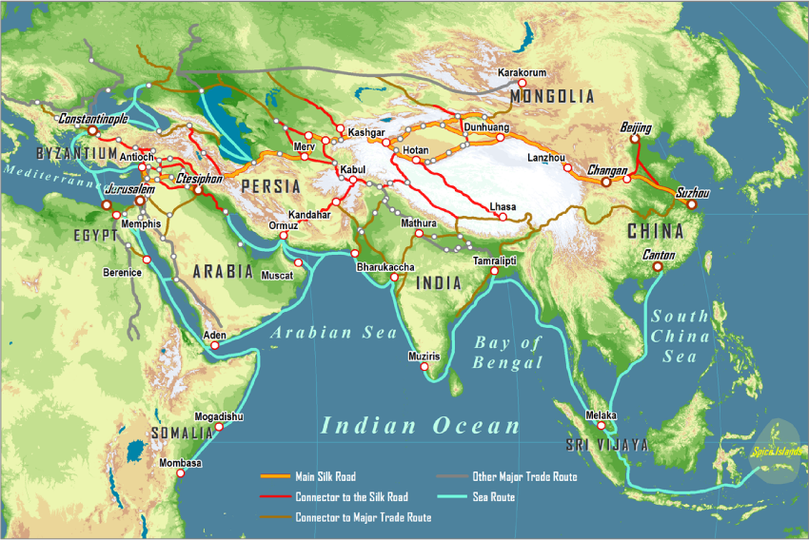
Silk Roads

Slide 23
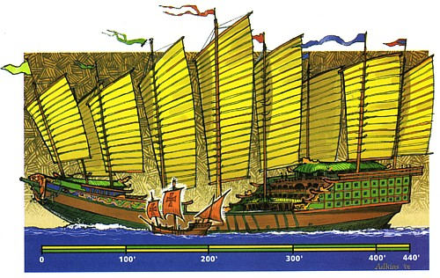
Indian Ocean Trade
Chinese Junks – refined in late Tang and Song period - are best ships in the world
Established market networks along Indian ocean coast
Rival Arab control of Indian Ocean
Compasses used to increase accuracy in navigation
A typical junk compared to Columbus' Santa Maria

Slide 24
Expanding Agrarian Production
Economy stimulated by advances in farming
Tang and Song rulers try to promote agricultural production and peasants
New areas cultivated as China expands
Canals help transport produce quickly
Developments: new seeds, improved water control, wheelbarrow
Tang and Song break up aristocratic estates
Divided among peasants more equally

Slide 25
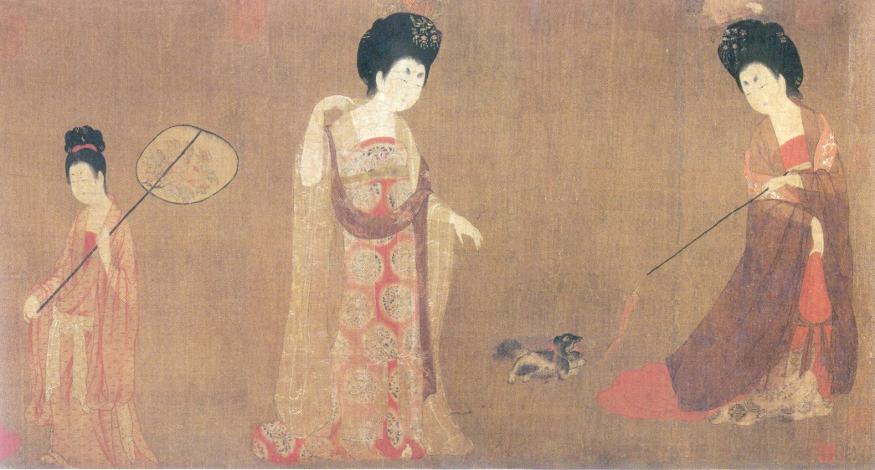
Family in the Tang-Song Era
Extended family households preferred
Male-dominated and respect for elders supported by Neo-Confucians
Elite women have broader opportunities
Examples: Empress Wu and Yang Guifei
Divorce widely available if both husband and wife consent

Slide 26
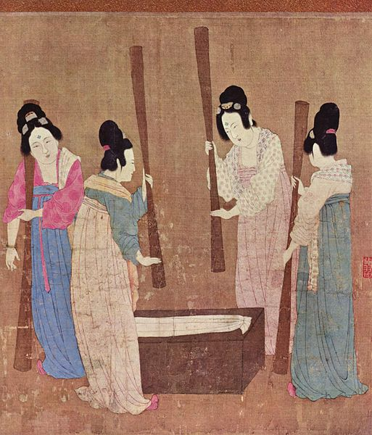
Neo-Confucian Support of Male Dominance
Neo-Confucians reduce role of women in late Song period
Physical confinement: stress women’s role as homemakers and mothers
Virtues: virginity for girls, fidelity for wives, chastity for widows
Men allowed great freedom, favored in inheritance and divorce
Education: Girls not educated, boys are emphasis

Slide 27
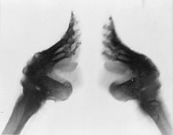
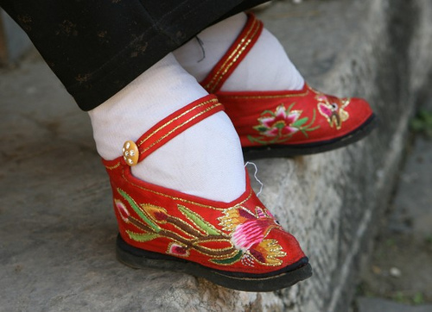
Foot-binding
Illustrates degree to which women were subordinated, controlled, and physically confined
Feet of girls 2-5 years old are bound
Ideal length: 3 inches
Bone-breaking, muscle-deforming process
Extremely painful, severely limit mobility
Considered highly attractive and erotic by men
Originates in Five Kingdoms period, possibly among court dancers, but then spreads in Song
Dies out in early 20th century; changing social norms

Slide 28
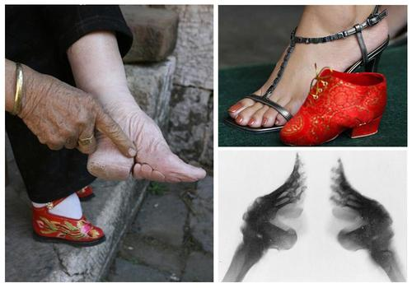
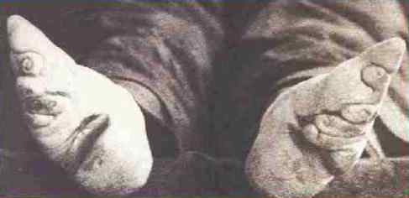

Slide 29
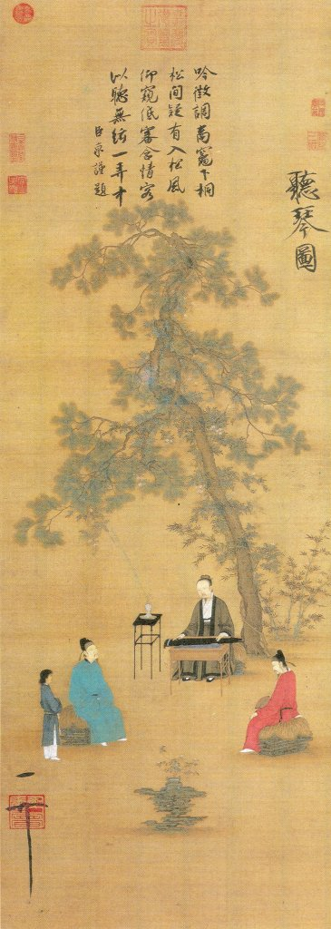
Cultural Achievements
Paper techniques refined
Gunpowder and fireworks (9th c.)
Abacus developed for counting
1041: Bi Sheng develops printing with moveable type
Scholars are now cultural producers
In past, Buddhists were artists
Secular scenes now more common (again, result of Neo-Confucians)
Nature: common theme in poetry, art

