Slide 1
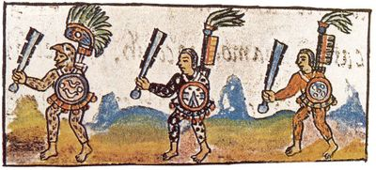
Chapter 11: The Americas on the eve of invasion
AP World

Slide 2
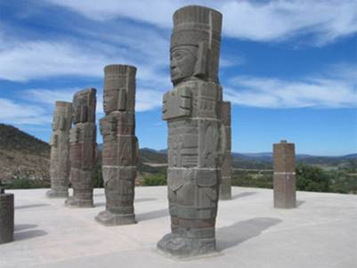
Toltecs: Precursors to the Aztecs
Pre-Columbian: before the voyages of Columbus and the conquests of the Spanish
Groups are developing in isolation
Toltec Empire in central Mexico
Capital at Tula, 968
Created a large empire whose influence extends beyond central Mexico
Long-distance trade to American SW
Belief in Quetzalcóatl
Heavily militaristic (sacrifice, war)
1150: Collapse, probably caused by northern nomads
Toltec Warrior Statues

Slide 3
The Aztec Rise to Power
After Toltecs, political power and people move to shores along lakes in Mexico valley
Lakes provide: fishing; farming; transportation
Early 13th c: Aztecs migrate to shores
Many vie for control of lakes: winners are Aztecs
Speak Nahuatl (Toltec language); lends legitimacy to rule
1325: Aztecs found Tenochtitlan, on island in center of Lake Texcoco
1434: Aztecs dominate central valley and begin to conquer other city-states
Central valley inhabited by mixture of people dominated by powerful tribes organized into city-states
Establish a tribute empire: prisoners used for human sacrifices

Slide 4
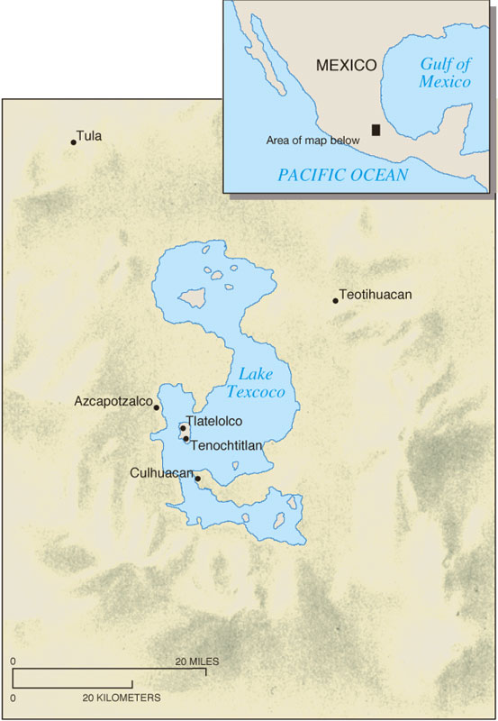
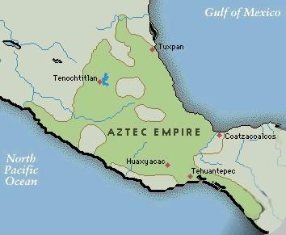
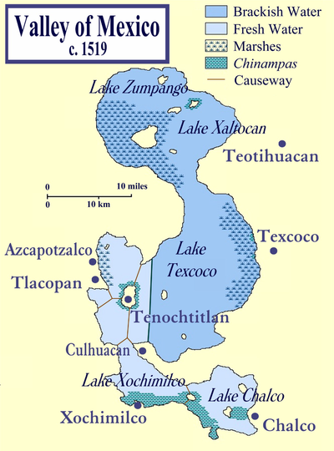
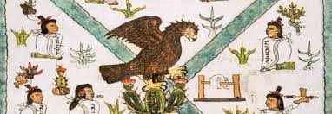

Slide 5
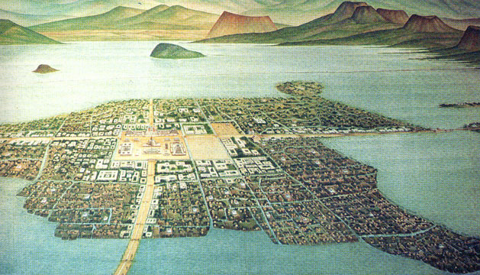

Slide 6
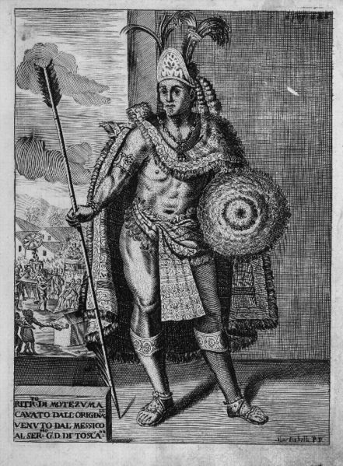
Aztec Society
Transformation from loose clans to hierarchical society
Ruler (Moctezuma II)
Head of state/religion
Representative of gods
Nobles
Peasants
Slaves (war captives)
Clans (calpulli) dictate social status
Social gaps widen (nobility vs. commoners)
Organized for war and motivated by religious zeal
Dedicated to service of gods

Slide 7
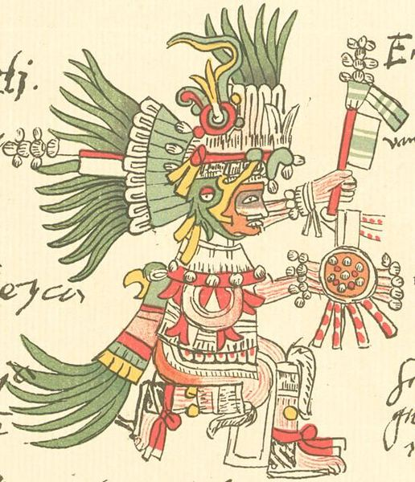
Aztec Religion
Spiritual and natural world seamless
Hundreds of deities (3 Groups: fertility, agriculture, water/rain)
Pay tribute to gods through festivals, ceremonies, feasting, dancing, warfare, and sacrifice
Sacrifices increased
Huitzilopochtli (deity of war, sun, and human sacrifice) needs strength
Patron of Tenochtitlan
Motivated by religious conviction? Or terror and political control?
Includes ritual cannibalism
War captives supply Aztecs with sacrificial victims

Slide 8
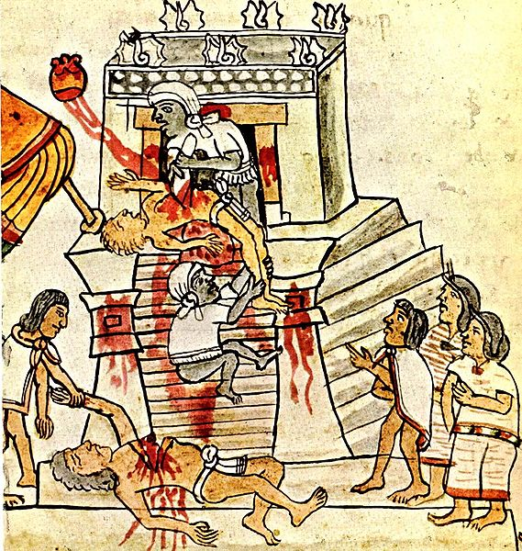
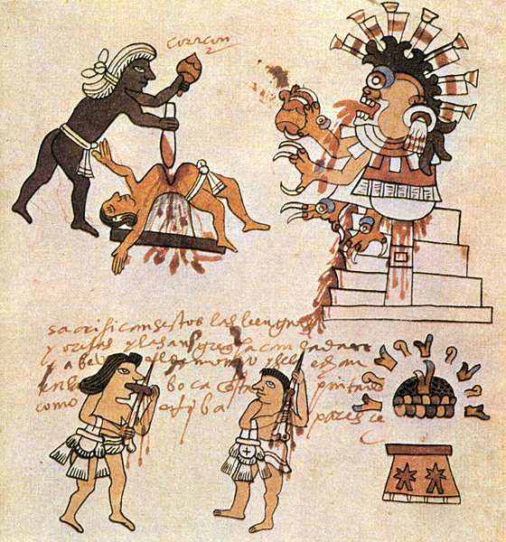

Slide 9
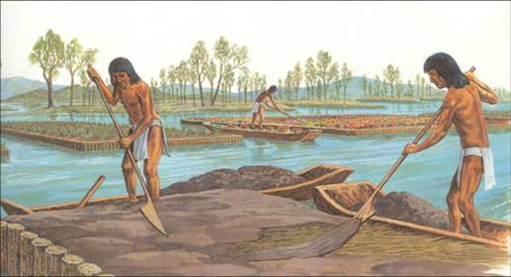
Aztec Economy
Agrarian community
Chinampas: man-made floating islands that yielded large amount of crops, constructed to provide additional farming land
Farming organized by clans; maize and beans
No use of wheel or laboring animals
Vibrant daily markets highly regulated by state

Slide 10
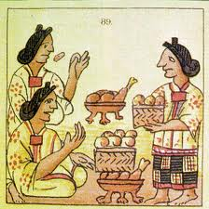
Gender and Technology
Women’s primary domain: household, cooking, weaving
Overcoming technological constraints
Grind corn by hand on stone boards; time-consuming
No wheels or suitable animals for power like Europe
Can own/inherit property and will it to heirs
Arranged marriages
Elite use polygamy, commoners are monogamous

Slide 11
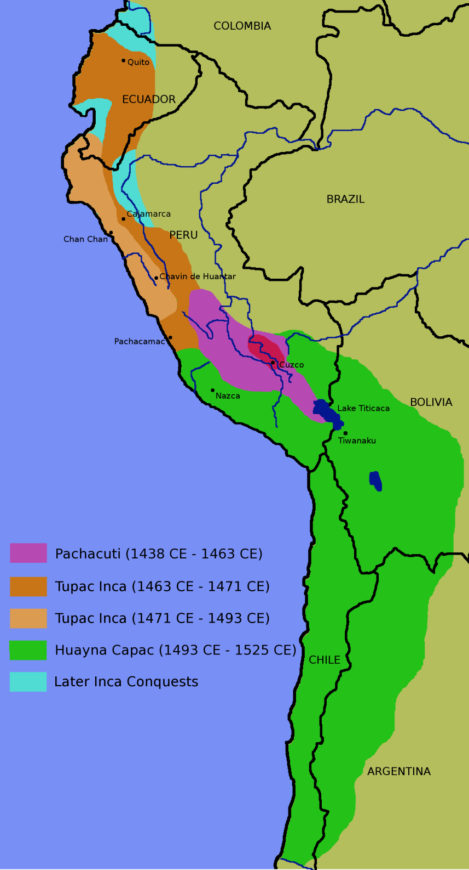
The Incas
Chimor Kingdom (900-1465)
Control of north coast of Peru
Incas conquer Chimors by taking over irrigation system
Inca Empire (Twantinsuyu)
Quechua-speaking clans (ayllus) in southern Andes
By 1350, they live in and around Cuzco (capital)
Control regions by 1438, under Pachacuti (ruler, or inca)
Centered around Lake Titicaca
Aggressive expansion for 60 years by Pachacuti, his son, and grandson
Inca Expansion

Slide 12
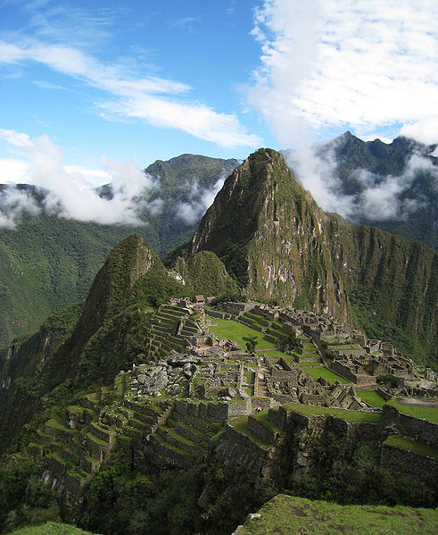
Techniques of Inca Imperial Rule
Highly centralized
Inca ruler; governors of four provinces; bureaucracy
Local rulers maintain their positions
Integrated various ethnic groups into an tribute empire (supply labor on government land)
Quechua is spread as language to unite empire
Military: System of roads, way stations (tambos), storehouses
Extensive irrigated agriculture; large building and irrigation projects
“Split inheritance” necessitates conquest
Power goes to eldest male; wealth and land to other sons

Slide 13
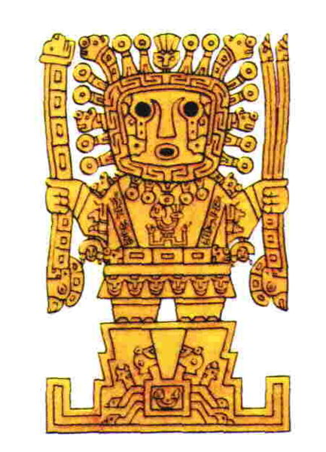
Inca Culture
Viracocha (creator/sun god) is highest
Temple of the Sun at Cuzco, center of state religion
Local gods survive
Cult of ancestors, deceased rulers mummified
Animism (mountains, stones, rivers, caves); considered holy shrines (huacas)
Cultural Achievements
Metallurgy (copper, bronze)
No writing system but knotted strings (quipu) for accounting
Monumental architecture (steep slopes)
Farming: potato; maize

Slide 14
Aztecs vs. Incas
Similarities
Built on earlier empires that preceded them
Aztecs = Toltecs
Inca = Chimor
Excellent organizers (imperial, military)
Intensive agriculture under state control
Clans transformed to hierarchy
Ethnic groups allowed to survive
However, Inca incorporate them into empire, while Aztecs rule them harshly
Animistic religion
Differences
Aztecs have sophisticated trade, markets; Inca have no separate merchant class
Aztecs developed a system of writing, while the Inca did not

Slide 15
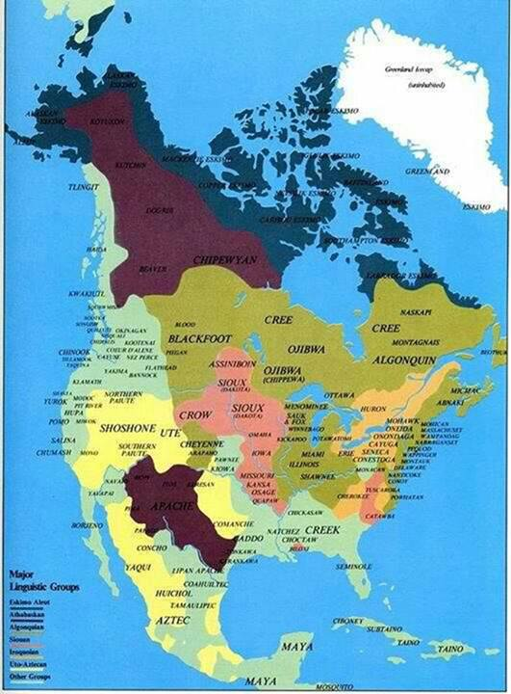
Peoples of the Americas
Major Linguistic Groups in North America
Great variety; adapt to their region
Some use irrigation
No states formed
Long distance/regional trade
Caribbean islands: hierarchical societies, divided into chiefdoms
Strongly resembled Polynesian societies
North America
1500: 200 languages
Agriculturalists; nomads
Two great imperial systems by 1500, but Mesoamerica and the Andes weakened by European contact
Communities are technologically behind Europeans, Chinese, Arabs

