Slide 1
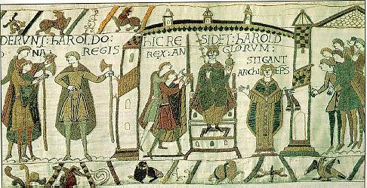
Chapter 10: A New Civilization Emerges in Europe

Slide 2
Overview of Middle Ages
Fall of Western Rome (5th c.) - decline of Europe’s feudal and religious institutions (15th c.)
Early Middle Ages (5th-10th): period of decline
High Middle Ages (10th-15th): period of slow emergence
Age of great faith (Christianity) with strong participation, and fervent spread of beliefs by missionaries
Increasing participation in trade with Asia and Africa.
In High Middle Ages, contact with Byzantines and Arabs through Crusades teaches Western scholars advances in math, science, philosophy.

Slide 3
Manorialism
System of economic organization between landlords and peasant laborers (serfs) who live on estates (manors)
Reciprocal obligations
Serfs were obligated to give their lord a portion of their produce
Lords protected serfs and provide everyday needs
Levels of production = low; technology = limited
Local level; no involvement of military because of localized nature
Agricultural unit of production and consumption
Local politics with regional aristocrats is most common form of organization until Vikings invade at large in 9th century → Western Europeans turn to feudalism for greater protection but manorialism is not abandoned

Slide 4
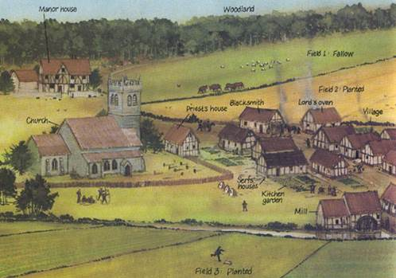
Manorialism

Slide 5
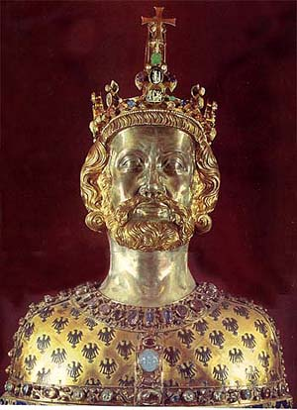
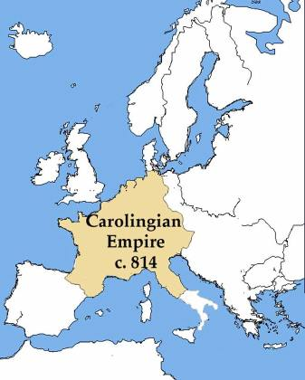
Charlemagne and the Carolingians
Frankish Carolingian dynasty grows in power (origins of modern France and Germany)
732: Charles Martel defeats Muslims in Battle of Tours
Charlemagne
800, establish empire in France and Germany
Pope’s coronation of Charlemagne as first Holy Roman Emperor sets precedent that Church approval is necessary for Western political power
843: Treaty of Verdun (empire fragments into three kingdoms)

Slide 6
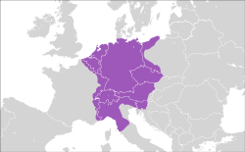
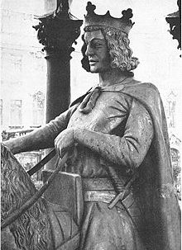
Holy Roman Empire
962-1806
Emerges from one kingdom (Germany, Italy) from Treaty of Verdun
Charlemagne is crowned HRE in 800
Position falls into disuse; empire falls into decline
Revived in 962: Otto I crowned HRE
Merge classical and Christian claims; proclaims itself a continuation of Ancient Rome
Provides a small amount of stability, but power of emperor was limited
Most of Germany still run by feudal lords and most of Italy in city-states
Dissolved in 1806 during Napoleonic Wars
Holy Roman Empire in 1600

Slide 7
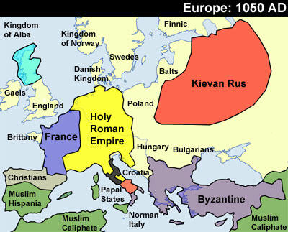

Slide 8
Feudal Monarchies
Military and political system
Rulers provided protection and aid to lesser lords (vassals)
Vassals owed rulers military service; goods; payments; counsel; sometimes receive land
Growth of strong feudal monarchy in Europe took many centuries
Absorbs manors into larger kingdoms
Result: regional monarchies with strong aristocracies
William the Conqueror, Duke of Normandy
Introduced feudal monarchy to England following Norman invasion in 1066
Declares that vassals must swear allegiance to him, not to lords

Slide 9
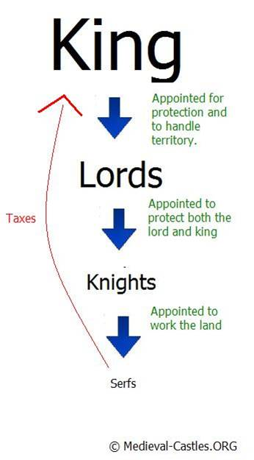
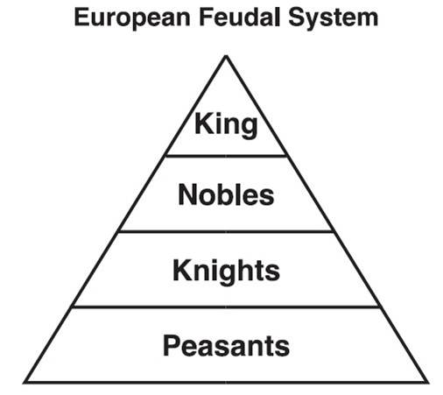

Slide 10
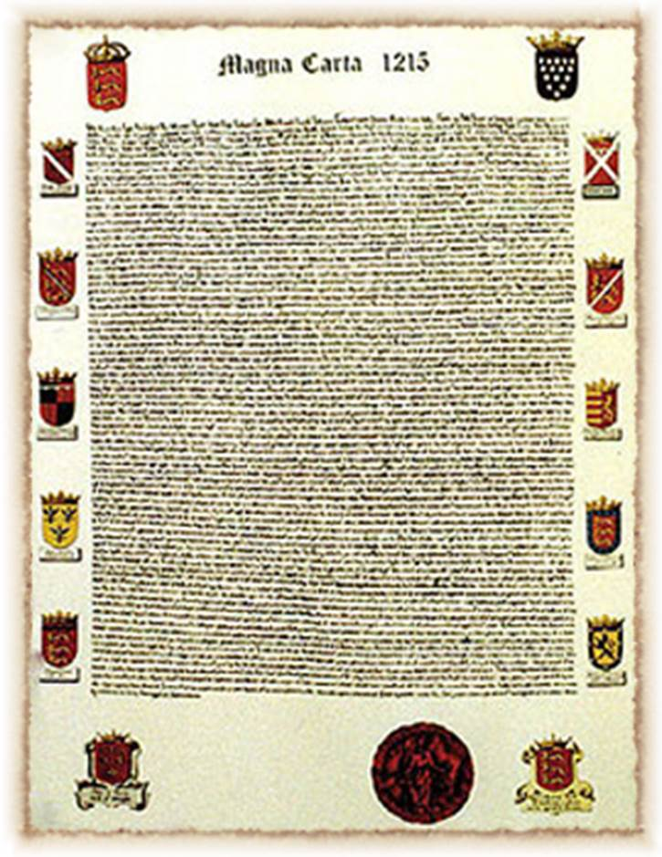
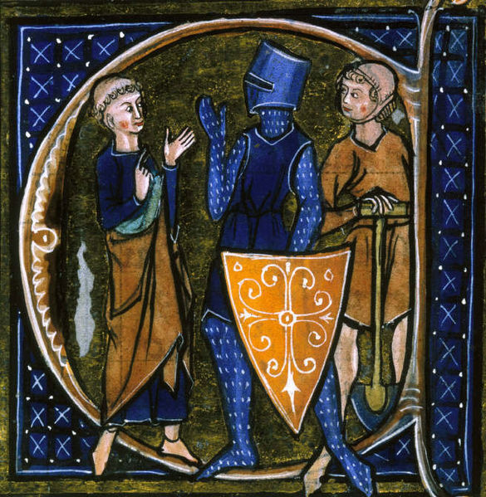
Limiting Government
Growth of monarchy cut into aristocratic power, so attempts are made to limit monarchical power
1215: Magna Carta
King John recognizes supremacy of written law; was forced by noblemen to adhere to it
Granted basic rights to noblemen
1265: first English Parliament
Serve as check on royal authority; collaboration between king and vassals
Three Estates (Church, Nobles, Commoners)
Rights according to estate in which you were born
However, monarchs continue to increase in power
Large conflicts like Hundred Years War lead to early ideas of nationalism with kings are leaders that embody countries’ principles

Slide 11
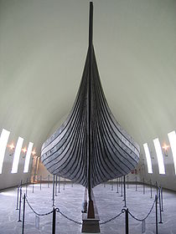
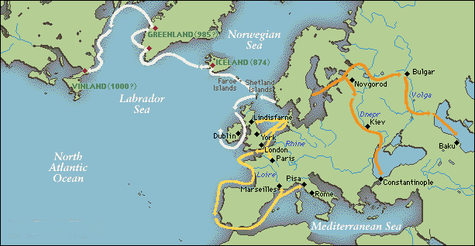
Vikings
Danish; Norwegian; Swedish
Raids from 8th to 11th centuries
Lightweight boats with wide hulls; stable and easily handled in rough water
10th c.: Begin to cease raids, convert to Christianity, and become settled peoples in Europe.
Continue to explore northern Atlantic (Iceland; Greenland; North America)
First European steps in Americas, Hudson Bay area

Slide 12
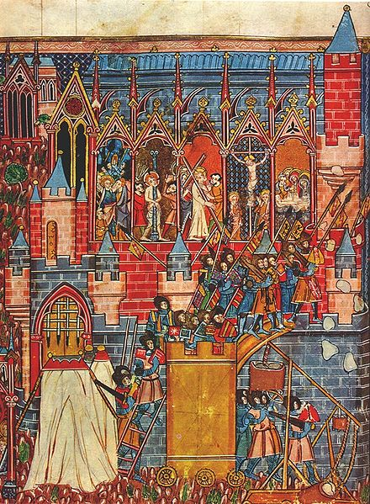
Crusades
Crusades (8 total)
Called by Urban II, 1095; end Muslim (Seljuk Turk) control of Holy Land
Initial success but ultimately end with defeat
Pass through Byzantine Empire (architectural achievements)
New contact with Islam and open western Europe’s eyes to new possibilities, especially trade
Sugarcane, spices, porcelain, glassware, carpets from East
Unbalanced trade: West wants Eastern goods
Show aggressive spirit of Western Europe

Slide 13
The Catholic Church
Catholic Church becomes most powerful and wealthy institution in West
Opportunities for abuse and corruption
Church sometimes owned large landholdings
Clear hierarchy of Church power like Roman government
Popes regulated doctrine
Just like “Royal Cult” of Islam, early Germanic kings were interested in Christianity

Slide 14
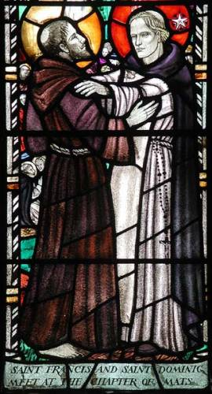
Religious Reform
1073-1085: Gregorian Reform with Gregory VII
Separation of secular and religious spheres
Try to free church from interference from states
Prove Church is superior to state
Quarrels with HRE Henry IV over investiture (whose right is it to appoint bishops? King or Pope?)
Several reform movements created to combat perceived corruption in Church
Mendicants, 13th century
St. Francis (Franciscans)
St. Dominic (Dominicans)

Slide 15
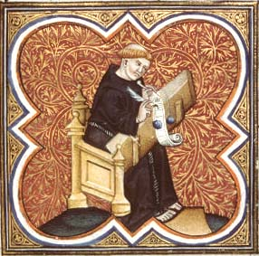
Monasticism
Aide in discipline of intense spirituality of devout Christians through celibacy and extreme piety
Example of holy life to ordinary people
Monasteries were pilgrimage centers
Intellectual life and literacy declines except among churchman in monasteries
Benedict of Nursia, 6th c.
Creates Benedictine rule for monks
Founder of Western monasticism

Slide 16
The High Middle Ages
11th - 15th centuries: emergence from the Dark Ages
Increased urbanization and declining manorialism
Increased social mobility
Increased trade with Asia
Increased economic activity and banking
Increased universities
Declining feudal political structures and emerging centralized monarchies
Strengthening of nation-states (Hundred Years’ War)
New warfare technology

Slide 17
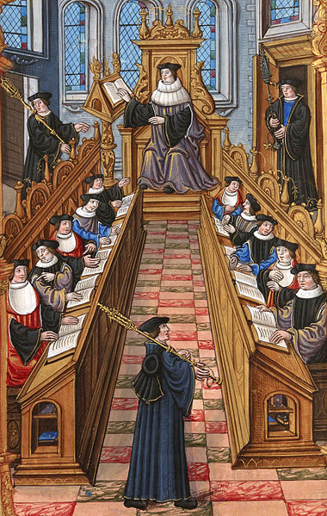
Urbanization and Education
Population increase, towns grow
Growing economy and markets
Literacy expands in urban centers
Decreasing Viking raids
Emphasis on education
From 11th c: Cathedral schools trained children to be future clergy members
From 13th c: Universities trained students in theology, medicine, law
Help to create economic and cultural vitality in Europe after 1000

Slide 18
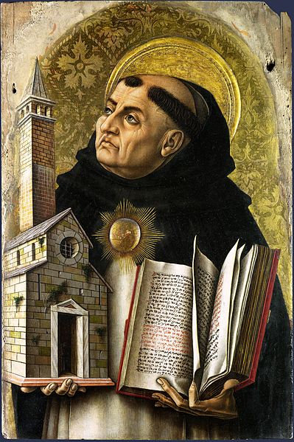
Theology
(Assimilating Faith and Reason)
Exploration of Greek philosophy and assimilation into Catholic religious tradition
Debate in universities: how to combine rational philosophy with Christian faith?
Bernard of Clairvaux, monk
Opposed to approach of integration of Greek philosophy into Catholic tradition
Supports mysticism (receive truth through faith and union with God)
Thomas Aquinas, Summas
faith is primary, but reason leads to understanding; therefore, one can reconcile Greek philosophy with Catholic theology
Scholasticism, 13th c., logic to resolve theological problems

Slide 19
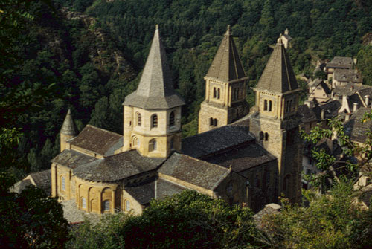
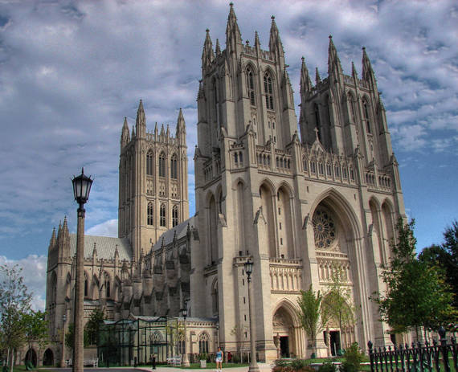
Religion in Art and Literature
Architecture, literature, and art reflect religious themes
Painting: wood panels, religious scenes, no perspective
Romanesque architecture: for pilgrimages, blocky, “Roman”-like
Gothic architecture: 11th c., verticality, light, intricacy, growing technical skills, expensive
Literature
Latin: law, education
Vernacular: secular literature (Chaucer’s Canterbury Tales; Beowulf)
Court poetry and chivalry

Slide 20
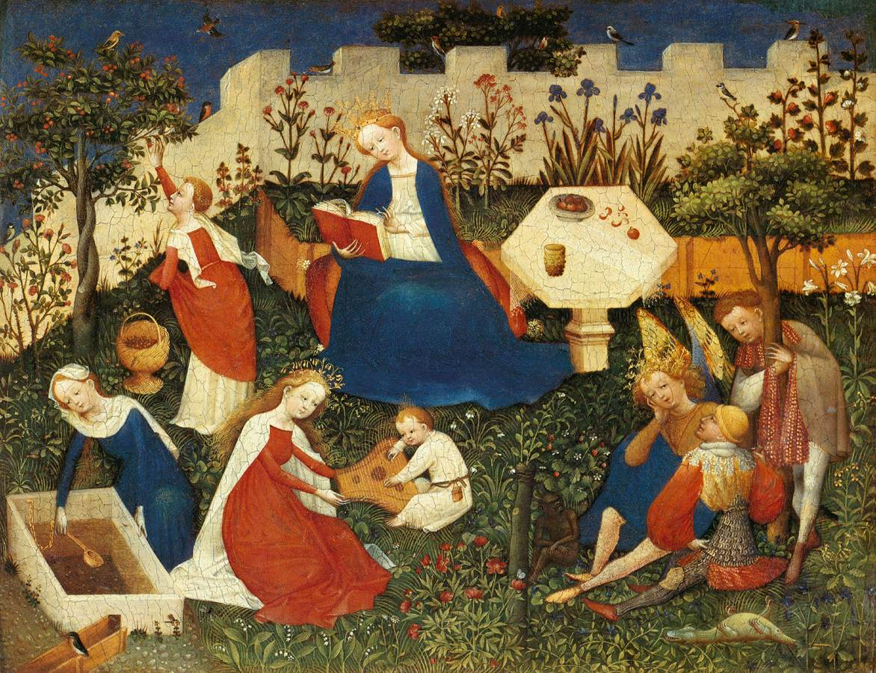

Slide 21
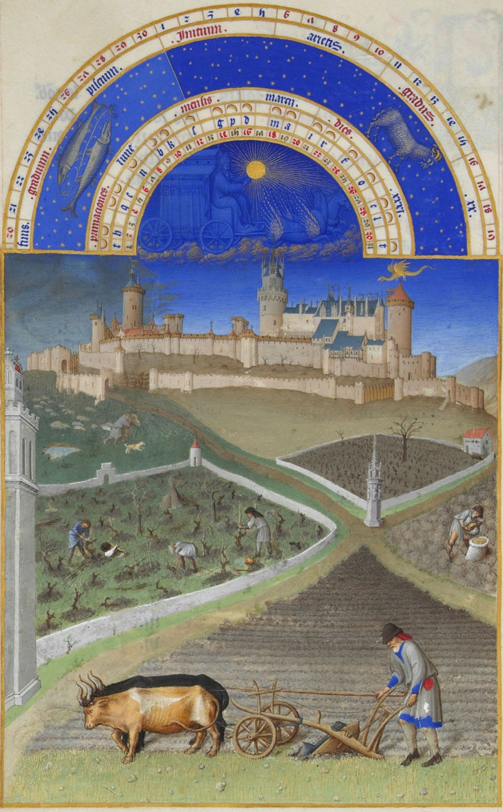
Agricultural Innovations
Moldboard: curved iron plate, allowed deeper turning of heavy soil
Crop rotation: leave half of land uncultivated each year to restore soil, but limits productivity
Three-field system: Only 1/3 of land left unplanted
Agricultural improvements → increased production → population growth → increased size of urban areas
Peasants gain financial freedom with agricultural advances, some become free farmers with no landlord and move to cities
Moldboard and Crop Rotation

Slide 22
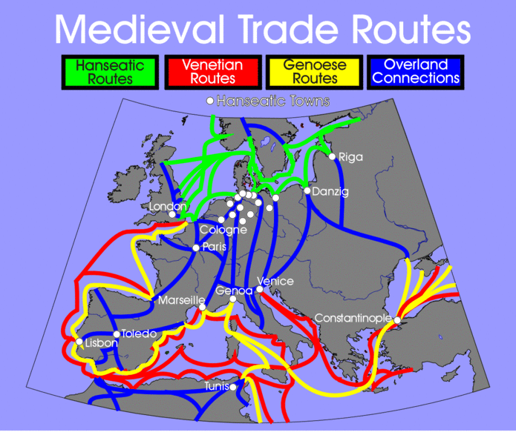
Growth of Trade and Banking
Low Countries: cloth; England: wool; France: wine; Scandinavia: timber; fish; fur
Money replaces barter system, and banking and insurance emerge
Hanseatic League
Confederation of merchant guilds and cities in Northern Europe working together for mutual economic benefit
Merchants asserted considerable power in trading cities as weak governments failed to regulate merchants
Merchants have low social status however; Christians raised concerns about capitalism and greed

Slide 23
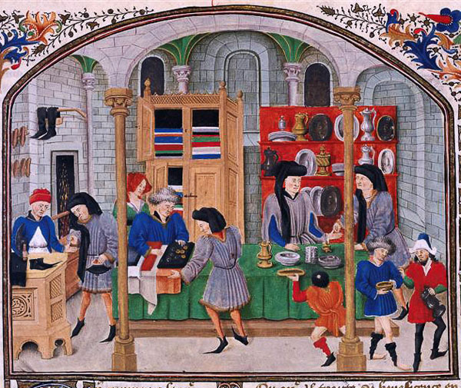
Guilds
Organizations that grouped people in the same business or trade in a single city
Stress financial security
Craft associations
Protect markets, set prices
Ensure standards, regulate apprenticeships, provide training and materials

Slide 24
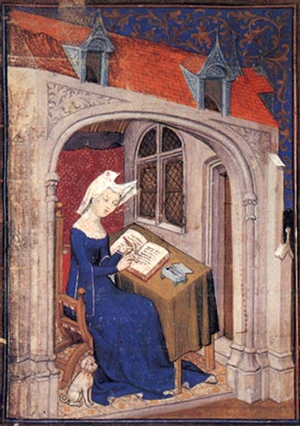
The Role of Women
Traditional roles: wife and childcare provider, patriarchal
Code of Chivalry: reinforced ideas that women were weak and subordinate
Nun: alternative to marriage
Two attitudes:
Veneration of Mary and female saints give women cultural and religious prestige
Emphasis on Eve as source of sin
No property rights but could trade and belong to some craft guilds
Growing literature discussing women’s roles as comforters to men, list docile virtues

Slide 25
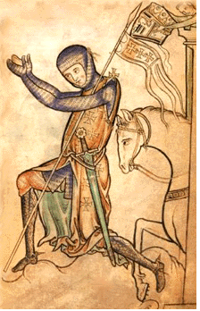
The Decline of the Medieval World
After 1300: overpopulation, severe famine; warfare, and disease
1348: Bubonic Plague (Black Death)
Kills ½ - 2/3 European population
Started in China; travels along Silk Road
Knights lose military purpose; become decorative
Foot soldiers more important and practical
Growth of professional armies; shook authority of feudal lords who used to supply armies
New weaponry (cannons, gunpowder); traditional methods (fortified castles) irrelevant
Example: Hundred Years War (1337-1453)
Aristocracy do not disappear; choose to live in rich ceremonial style that exhibits court life and chivalry

Slide 26
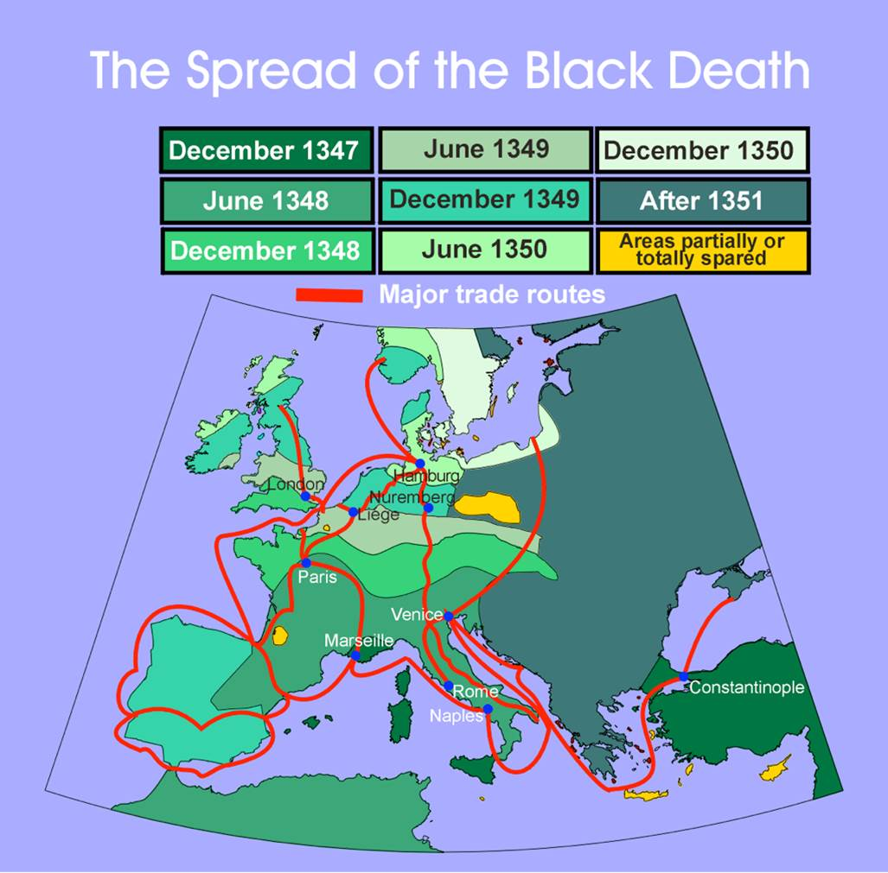

Slide 27
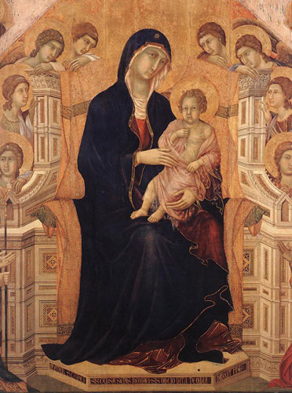
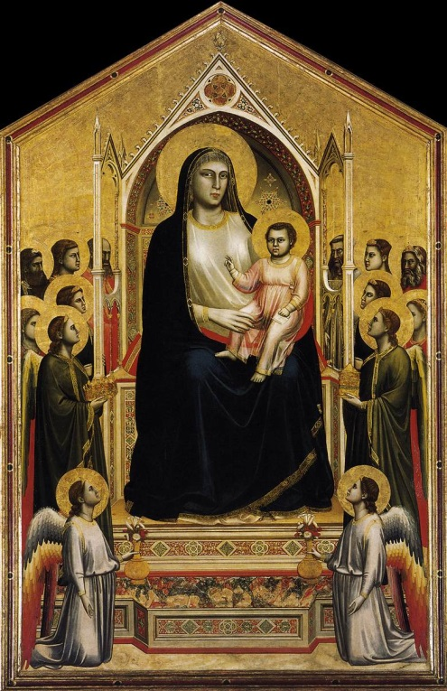
Changing Culture
Church increasingly rigid
Series of controversies over papal authority distance Church from everyday devotion (rival claimants to papacy)
Reformers and mystics emerge (no longer need Church to have direct experience with God)
Proto-Renaissance: Intellectual and artistic life develop
Art: realistic portrayals of space and nature, growing interest in the body

Slide 28
The Postclassical West and Its Heritage
“Middle Ages” implies lull between glory of Rome and glitter of Renaissance
Formative period
Backwardness and vulnerability
Dynamic change (trade, intellectual activity, Gothic)
Marked change in relationship between West and regions around it (Crusades and trade)
Europe originally at mercy of invasions (Vikings, nomadic groups from central Asia)
Nervous about power of Islam (false religion, deep threat to Christians and Holy Land)
Yet, actively copy Islam (law, science, art)

